Slide 1
TFIP-AI – Advanced Machine Learning
Unit 2 Clustering-1

Slide 2
Outline
Unit 1 – Support Vector Machine
Unit 2 – Clustering-1
Unit 3 – Clustering-2
Unit 4 – Dimensionality Reduction

Slide 3
Clustering

Slide 4
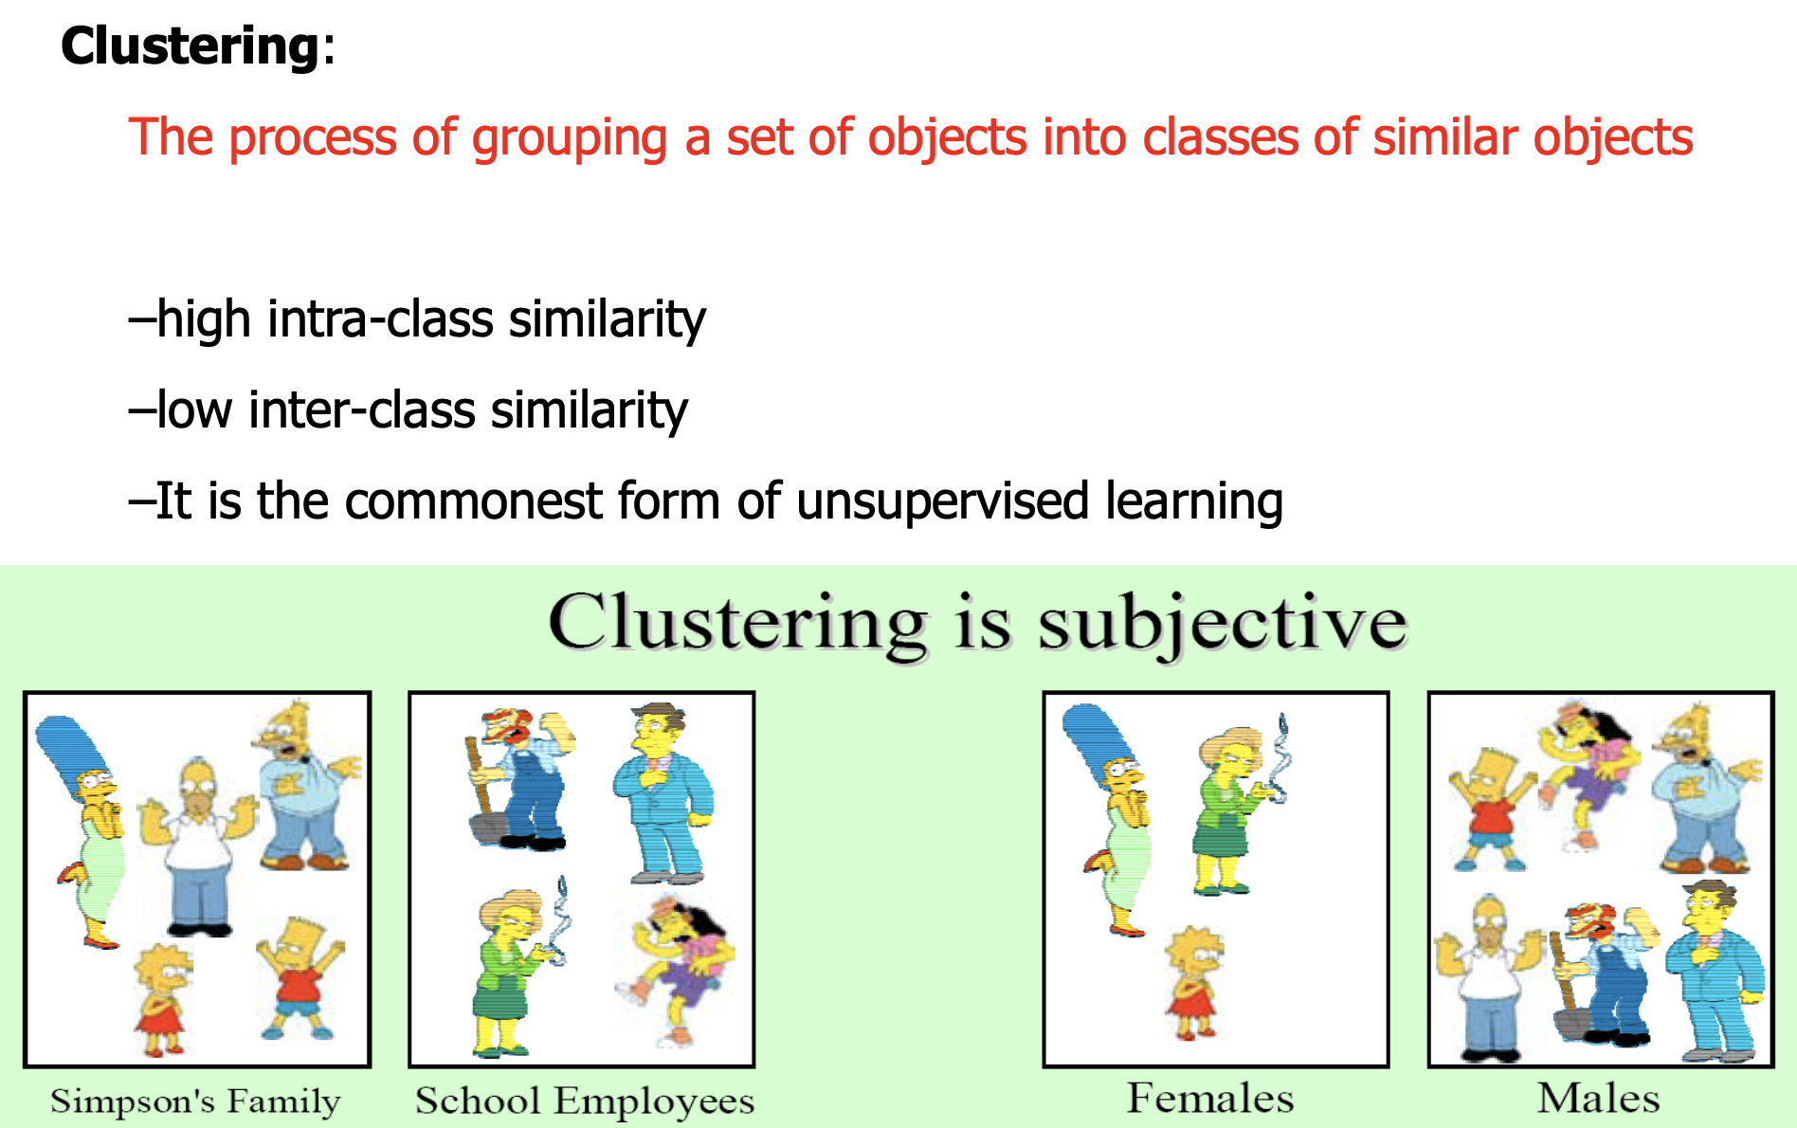
What is clustering?

Slide 5
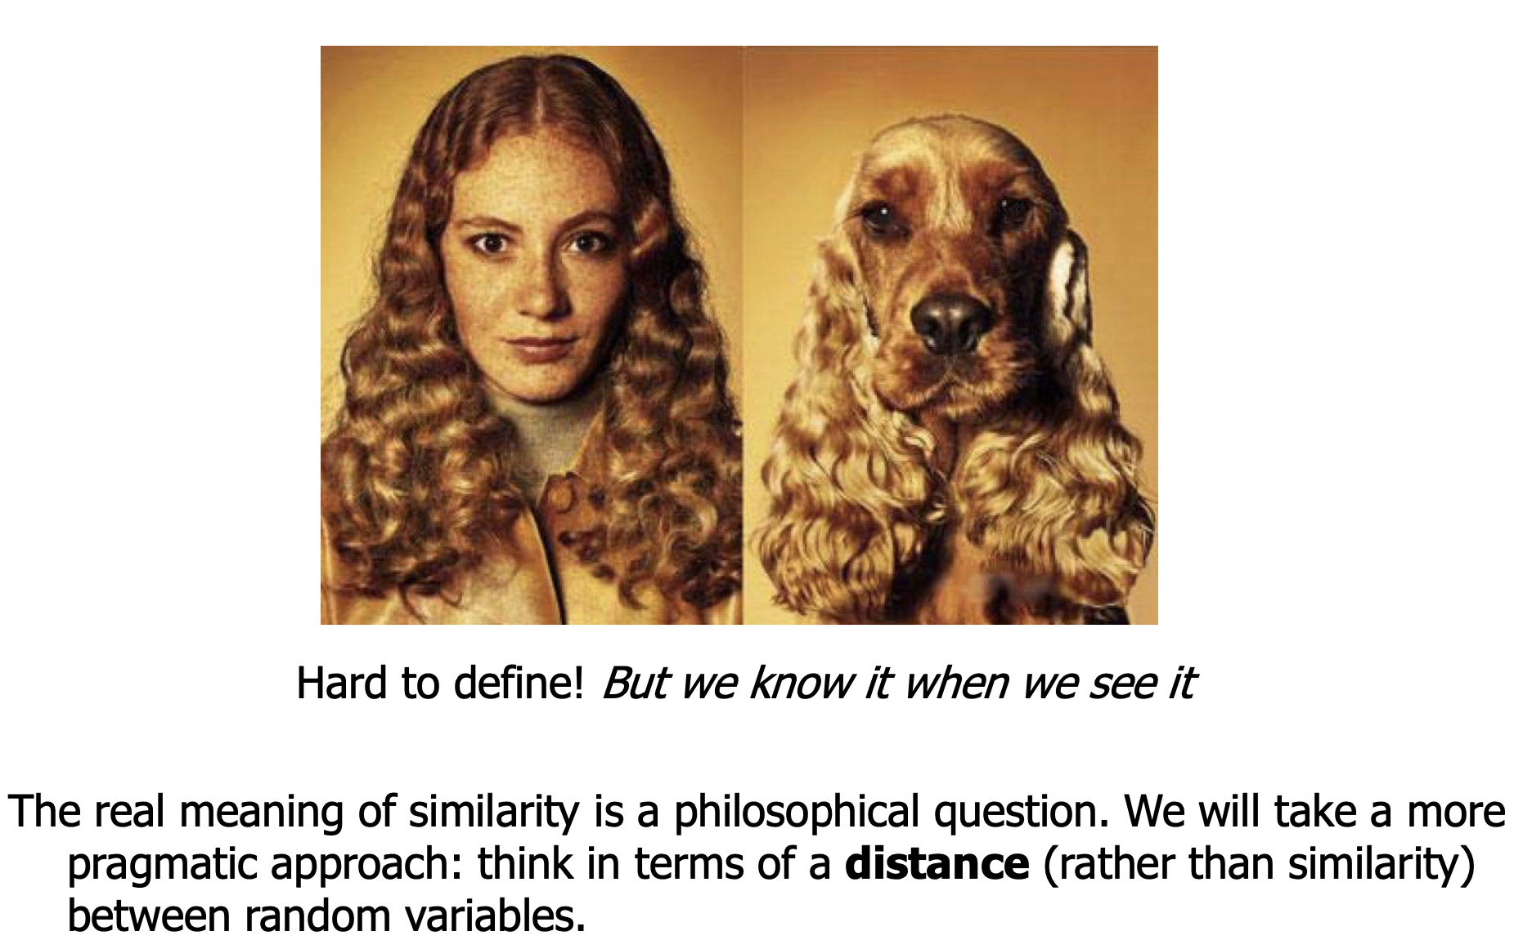
What is Similarity?

Slide 6
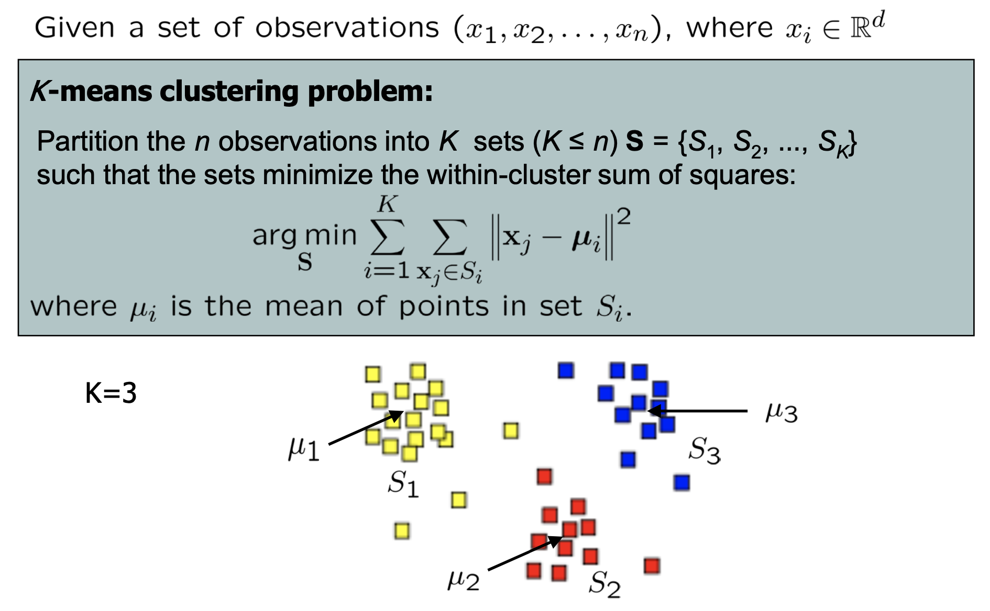
K-means Clustering Problem

Slide 7
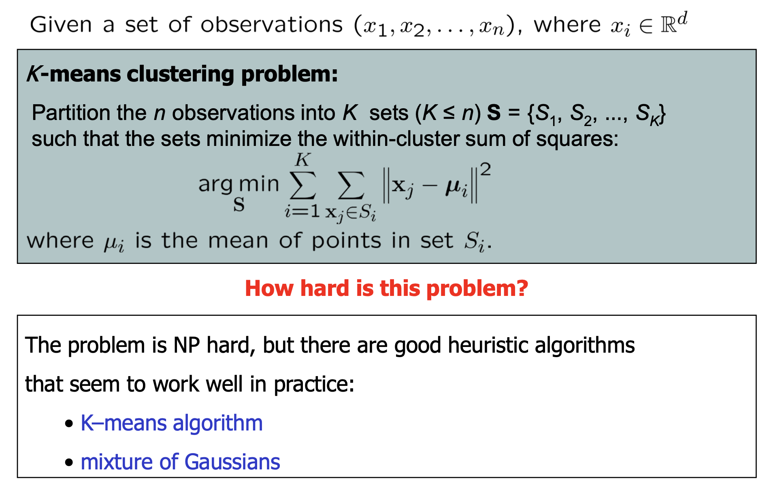
K-means Clustering Problem cont...

Slide 8
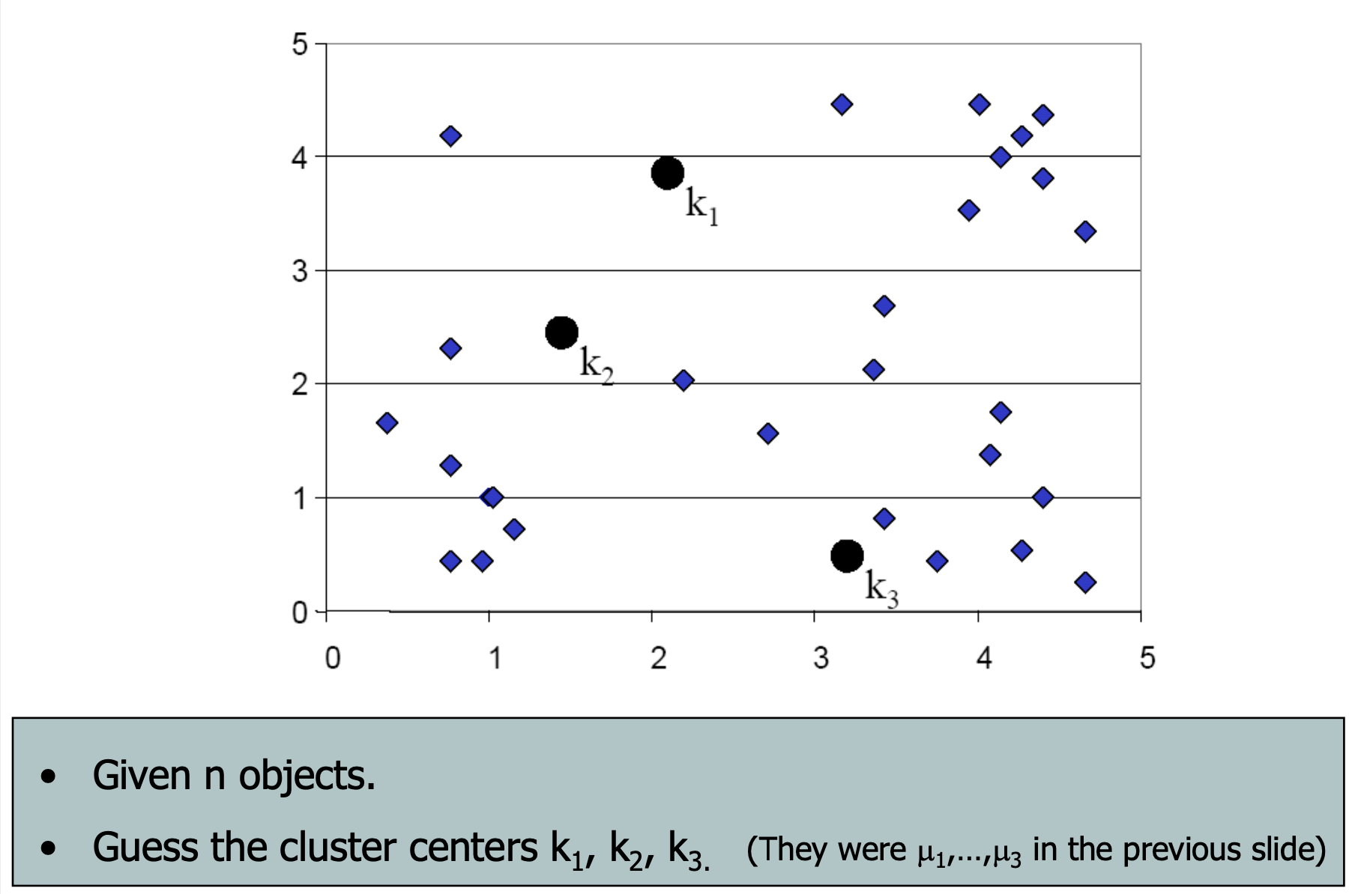
K-means Clustering Alg: Step 1

Slide 9
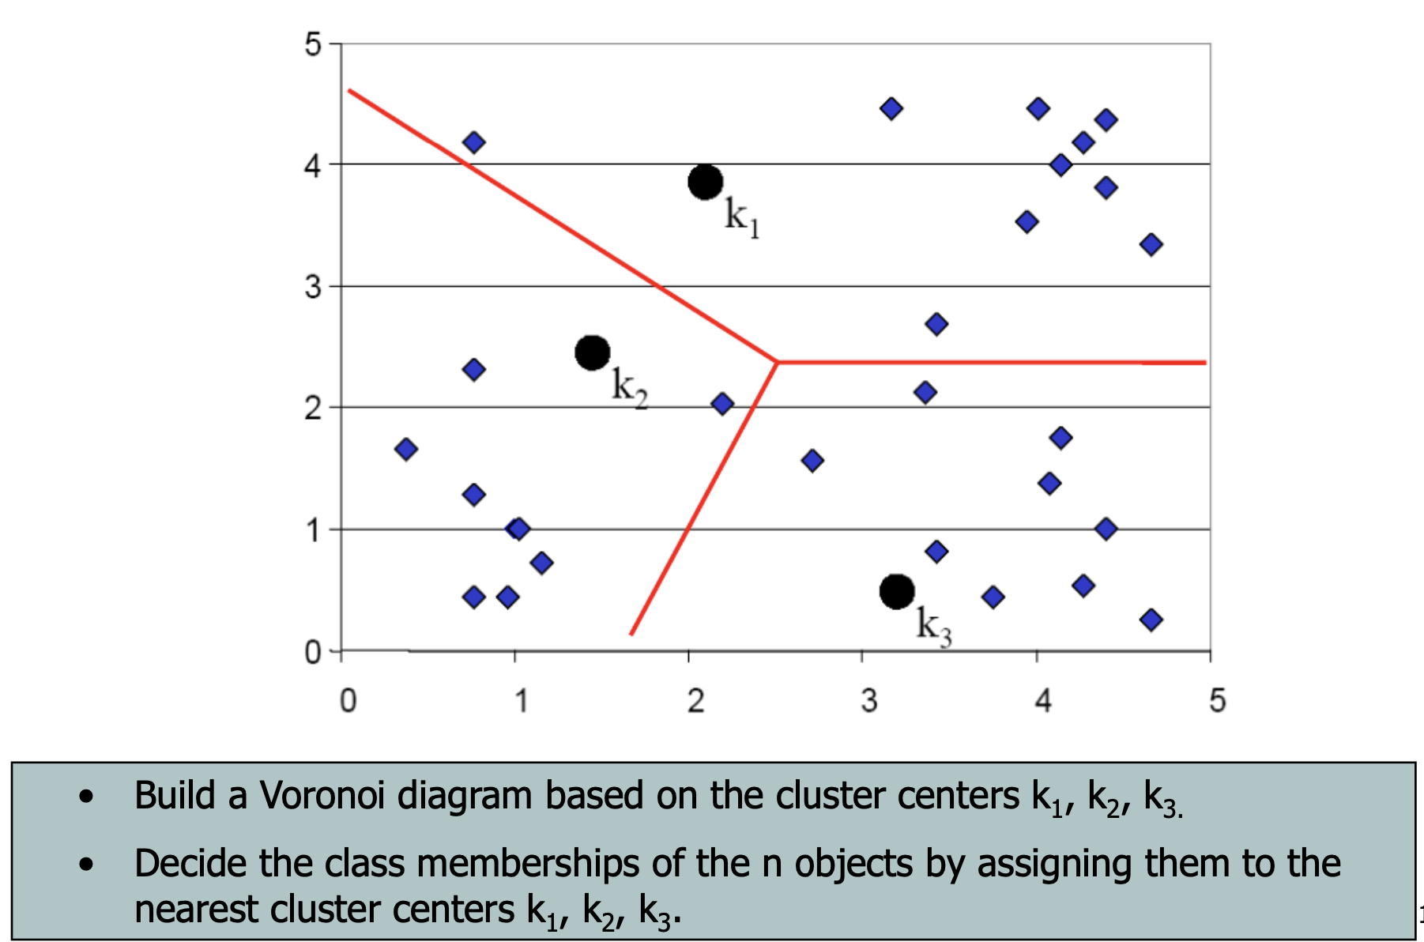
K-means Clustering Alg: Step 2

Slide 10
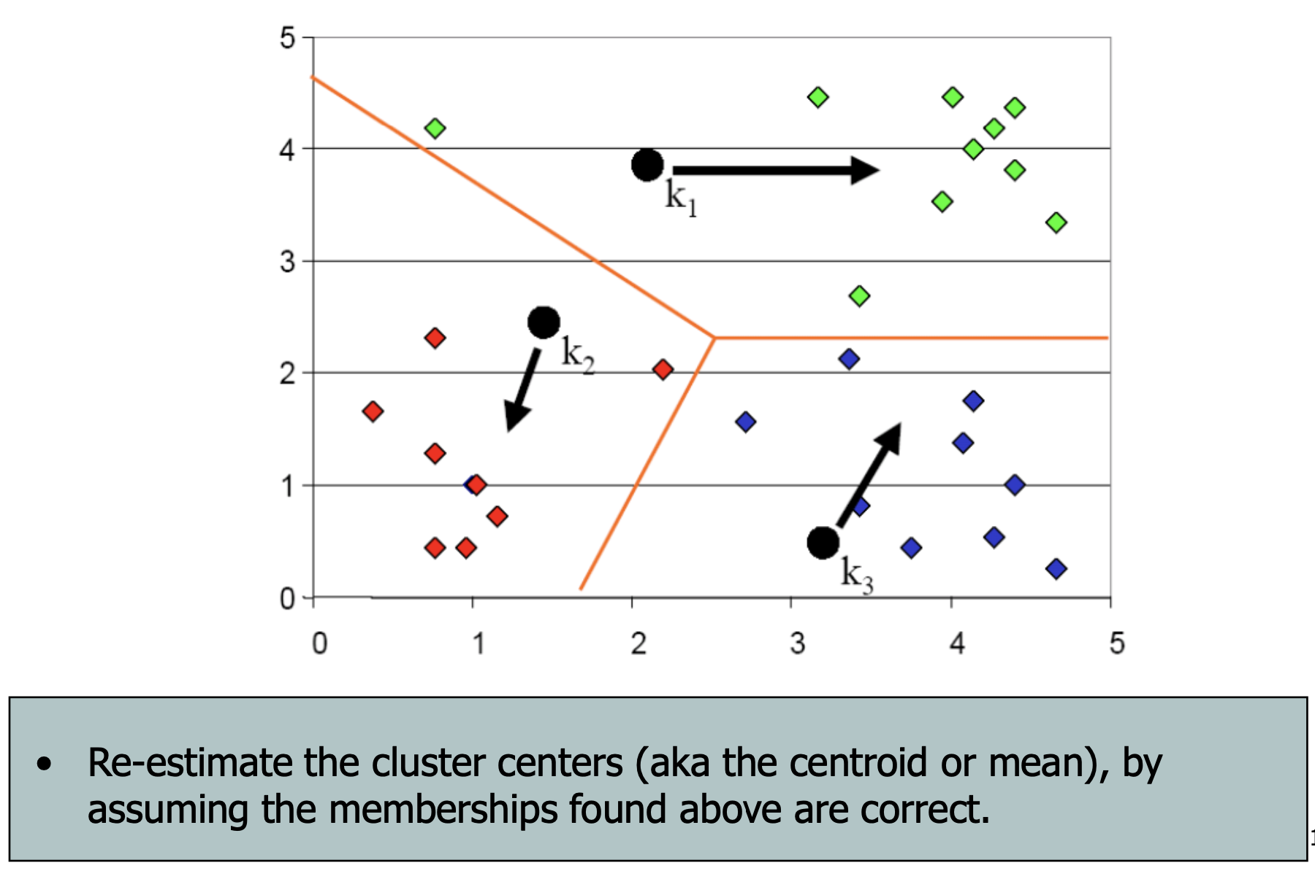
K-means Clustering Alg: Step 3

Slide 11
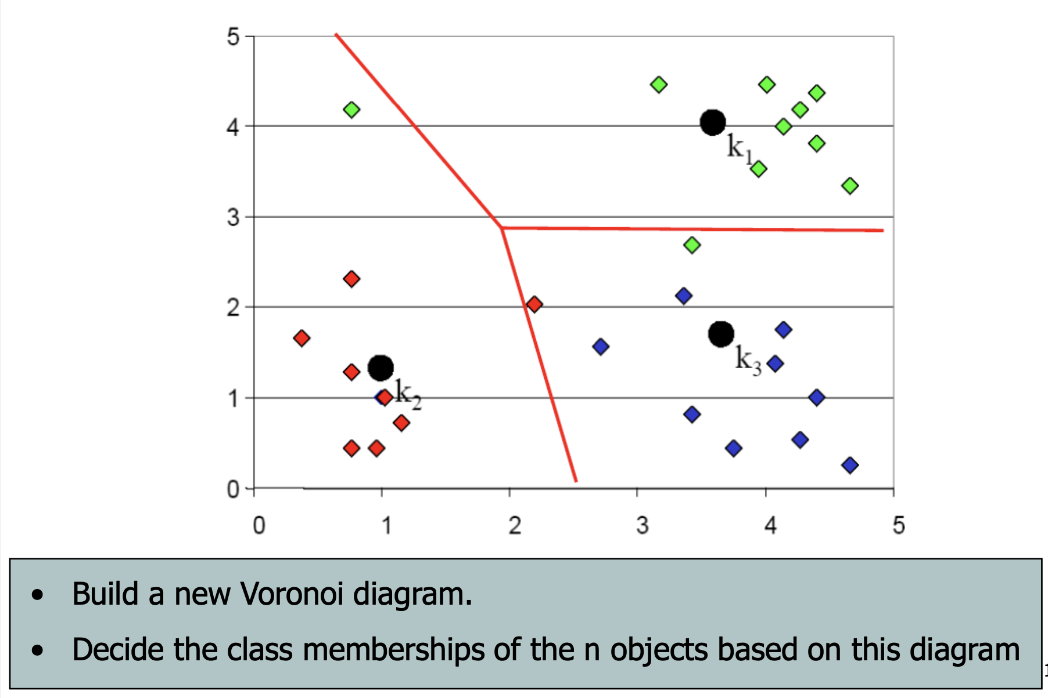
K-means Clustering Alg: Step 4

Slide 12

K-means Clustering Alg: Step 4

Slide 13
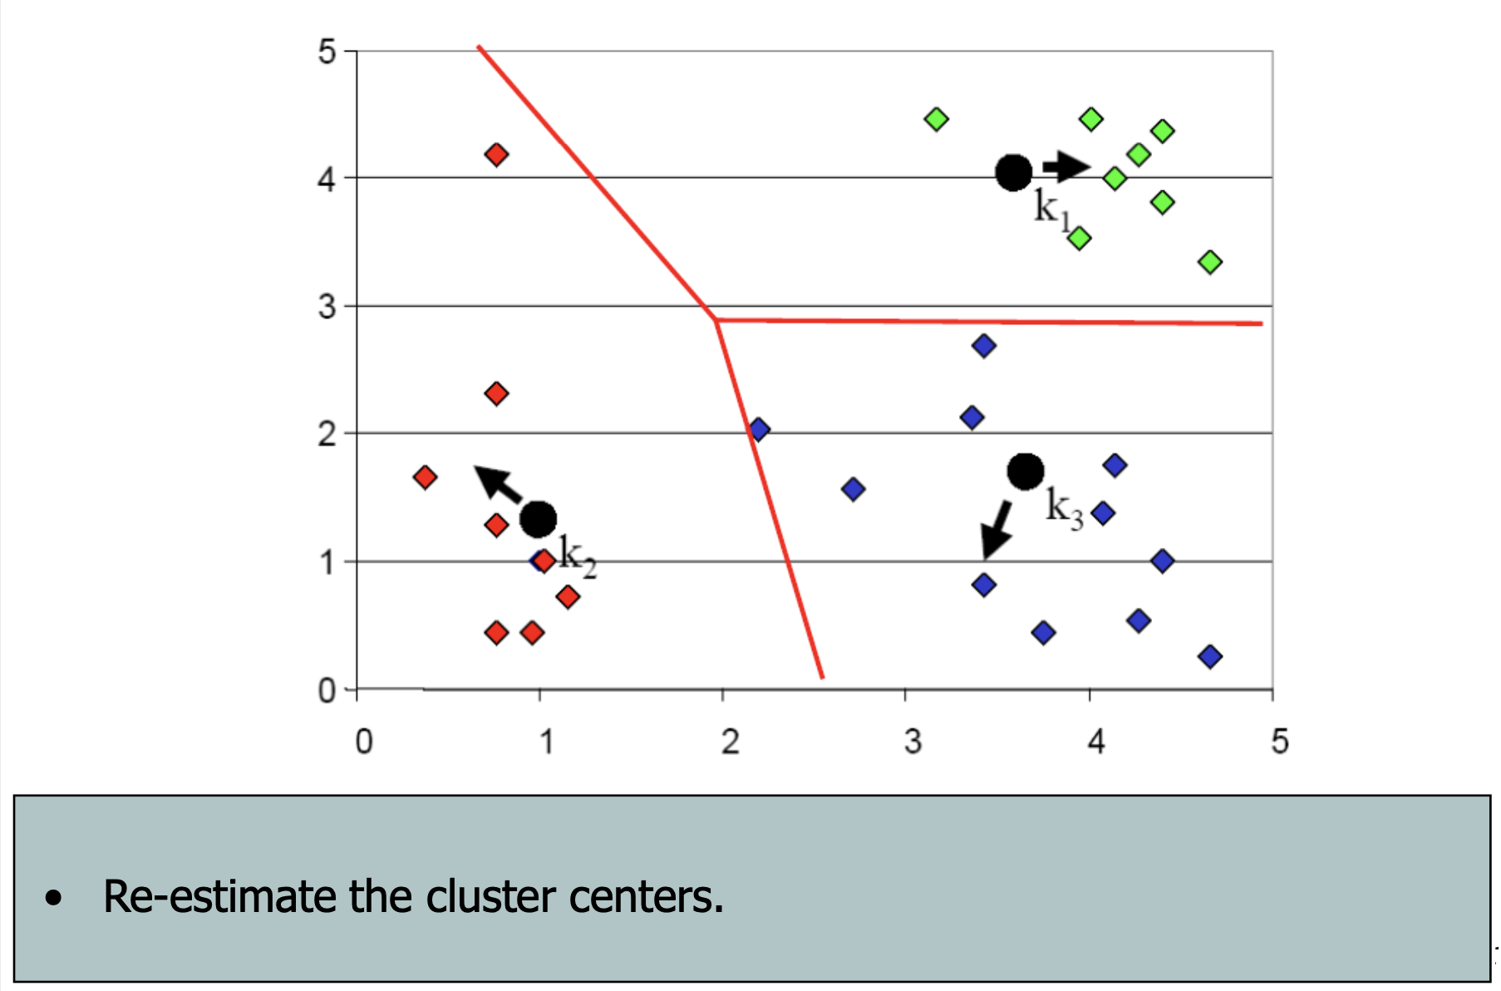
K-means Clustering Alg: Step 5

Slide 14
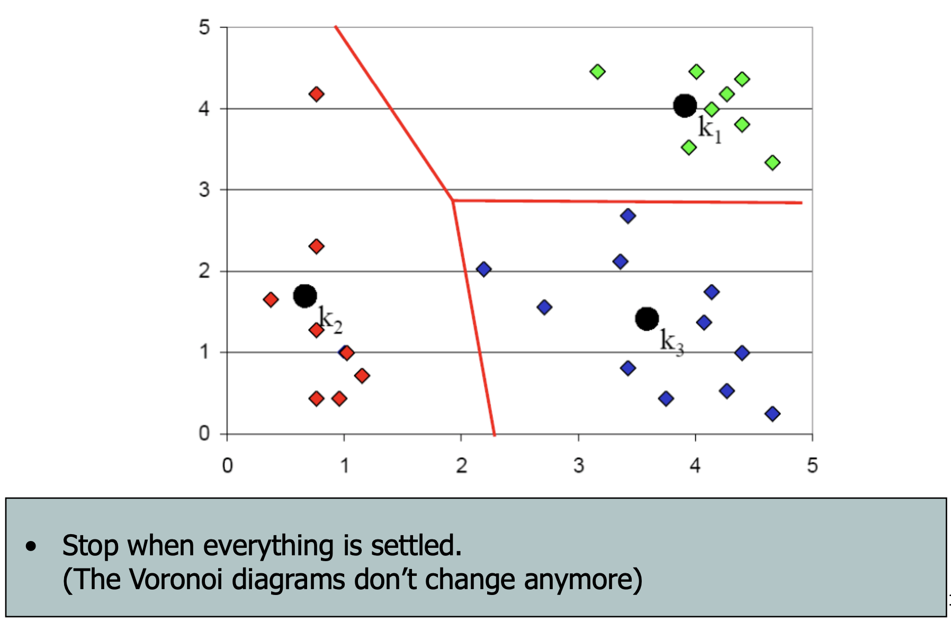
K-means Clustering Alg: Step 6

Slide 15
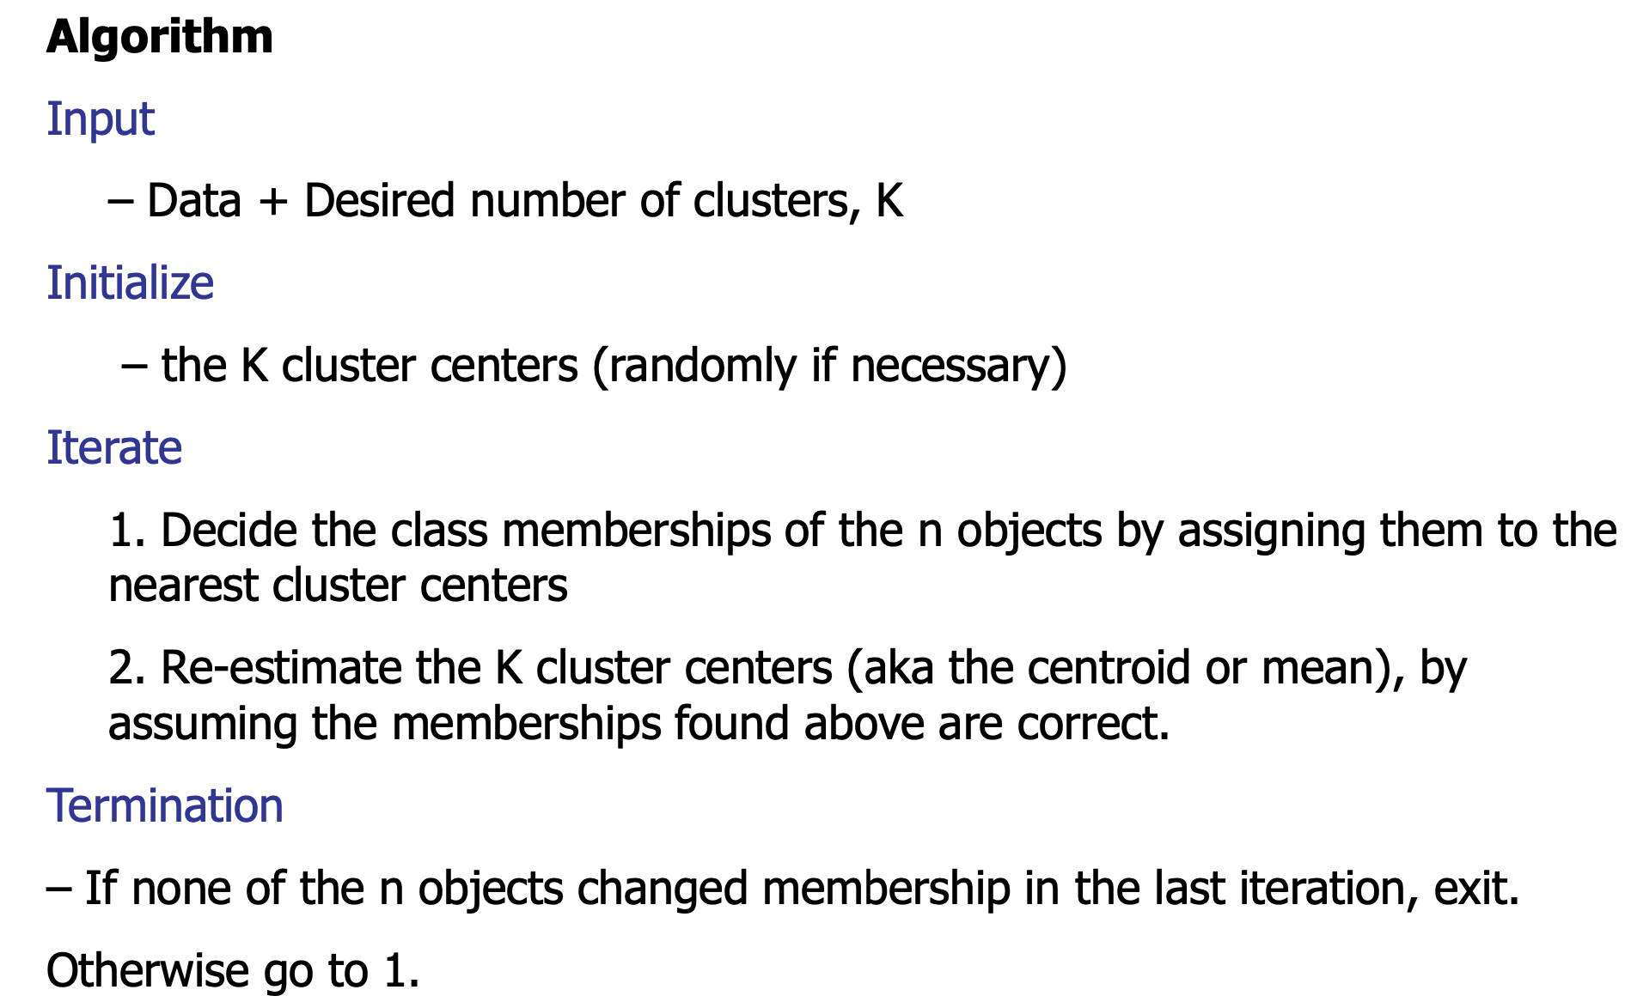
K-means Clustering Algorithm

Slide 16
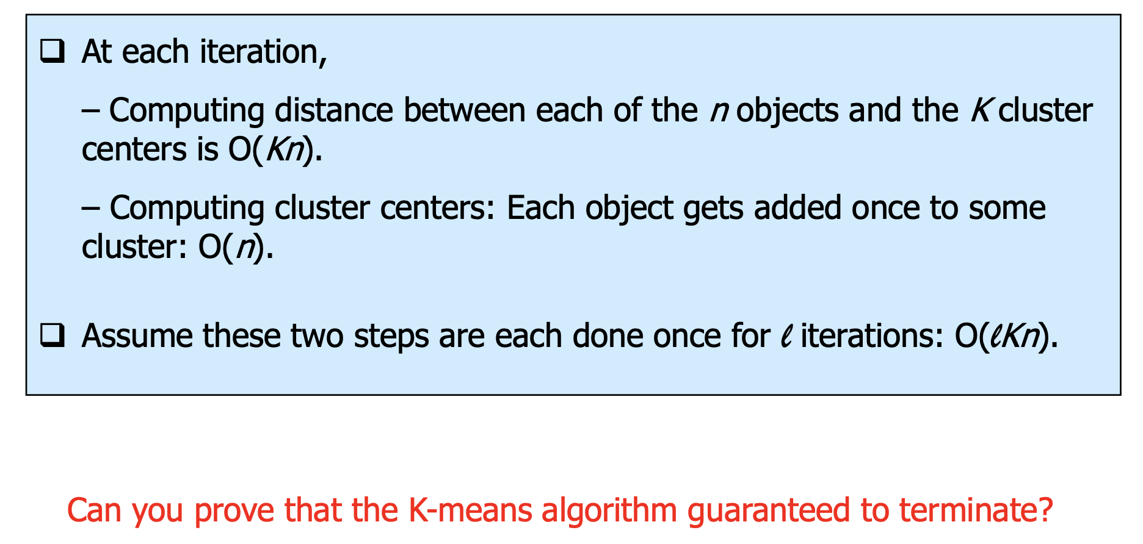
K-means clustering K-means Algorithm
Computation Complexity

Slide 17
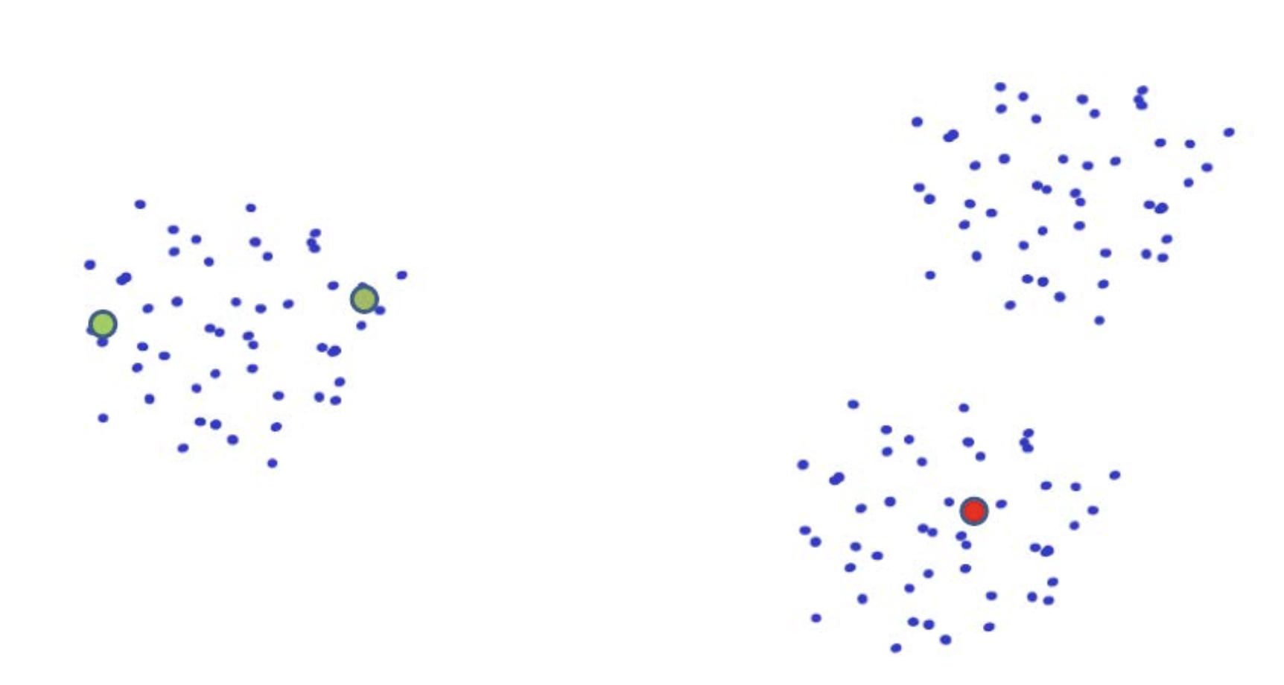
Seed Choice

Slide 18
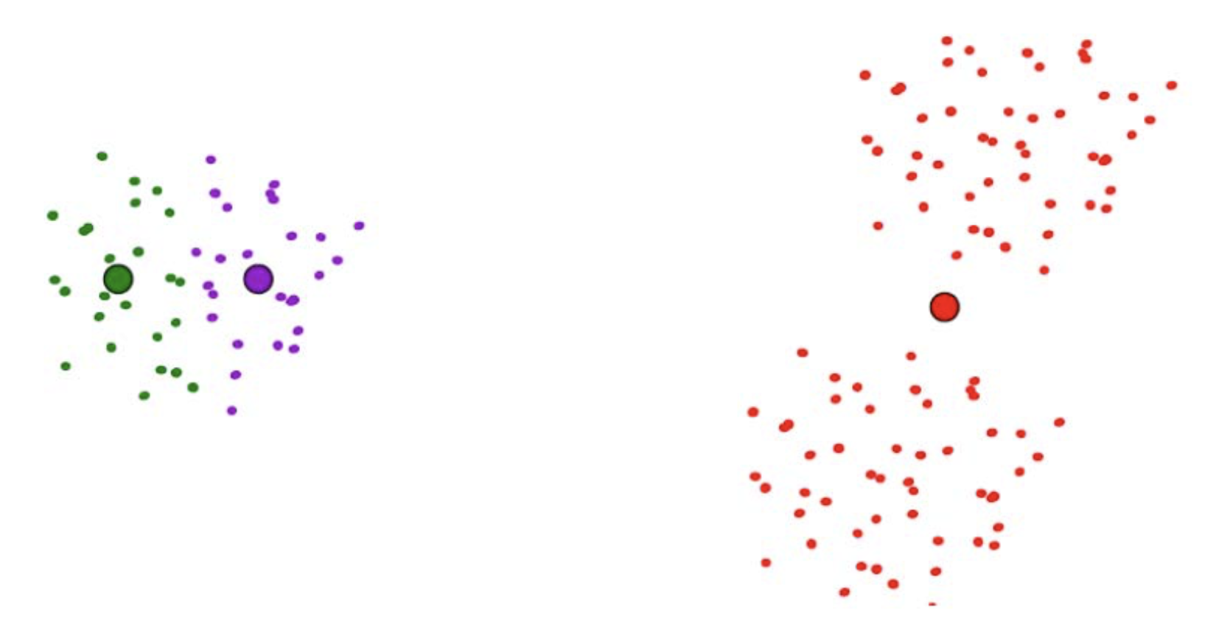
Seed Choice cont...

Slide 19
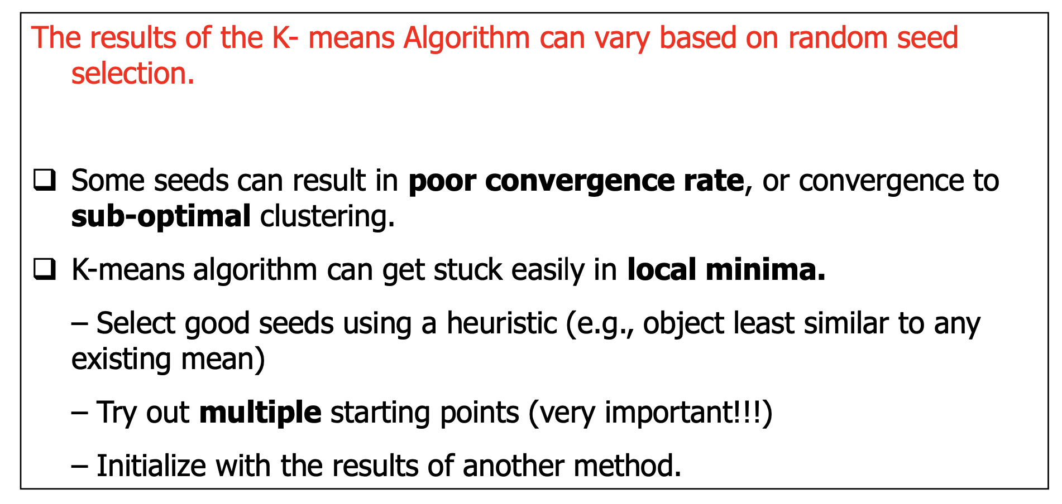
Seed Choice cont...

Slide 20
Alternating Optimization

Slide 21
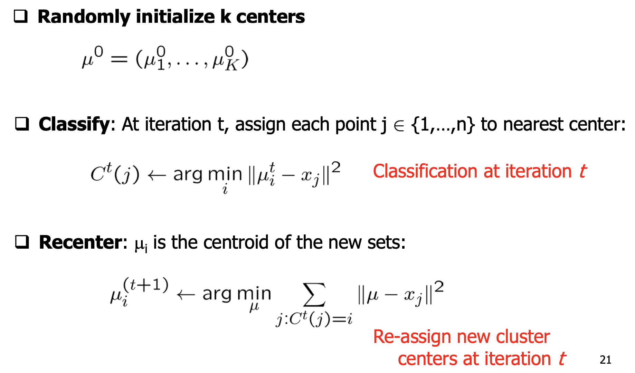
K-means Algorithm (more formally)

Slide 22
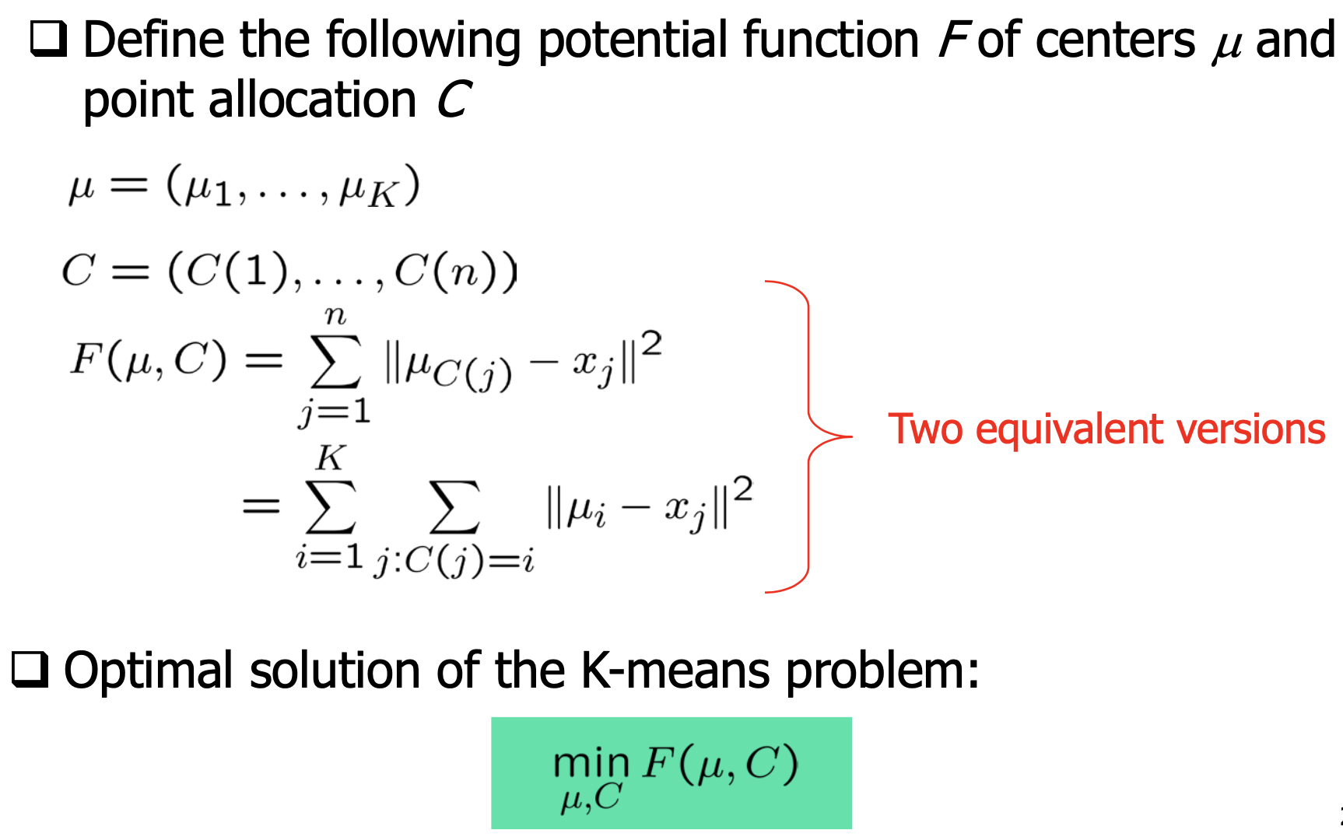
What is K-means optimizing?

Slide 23
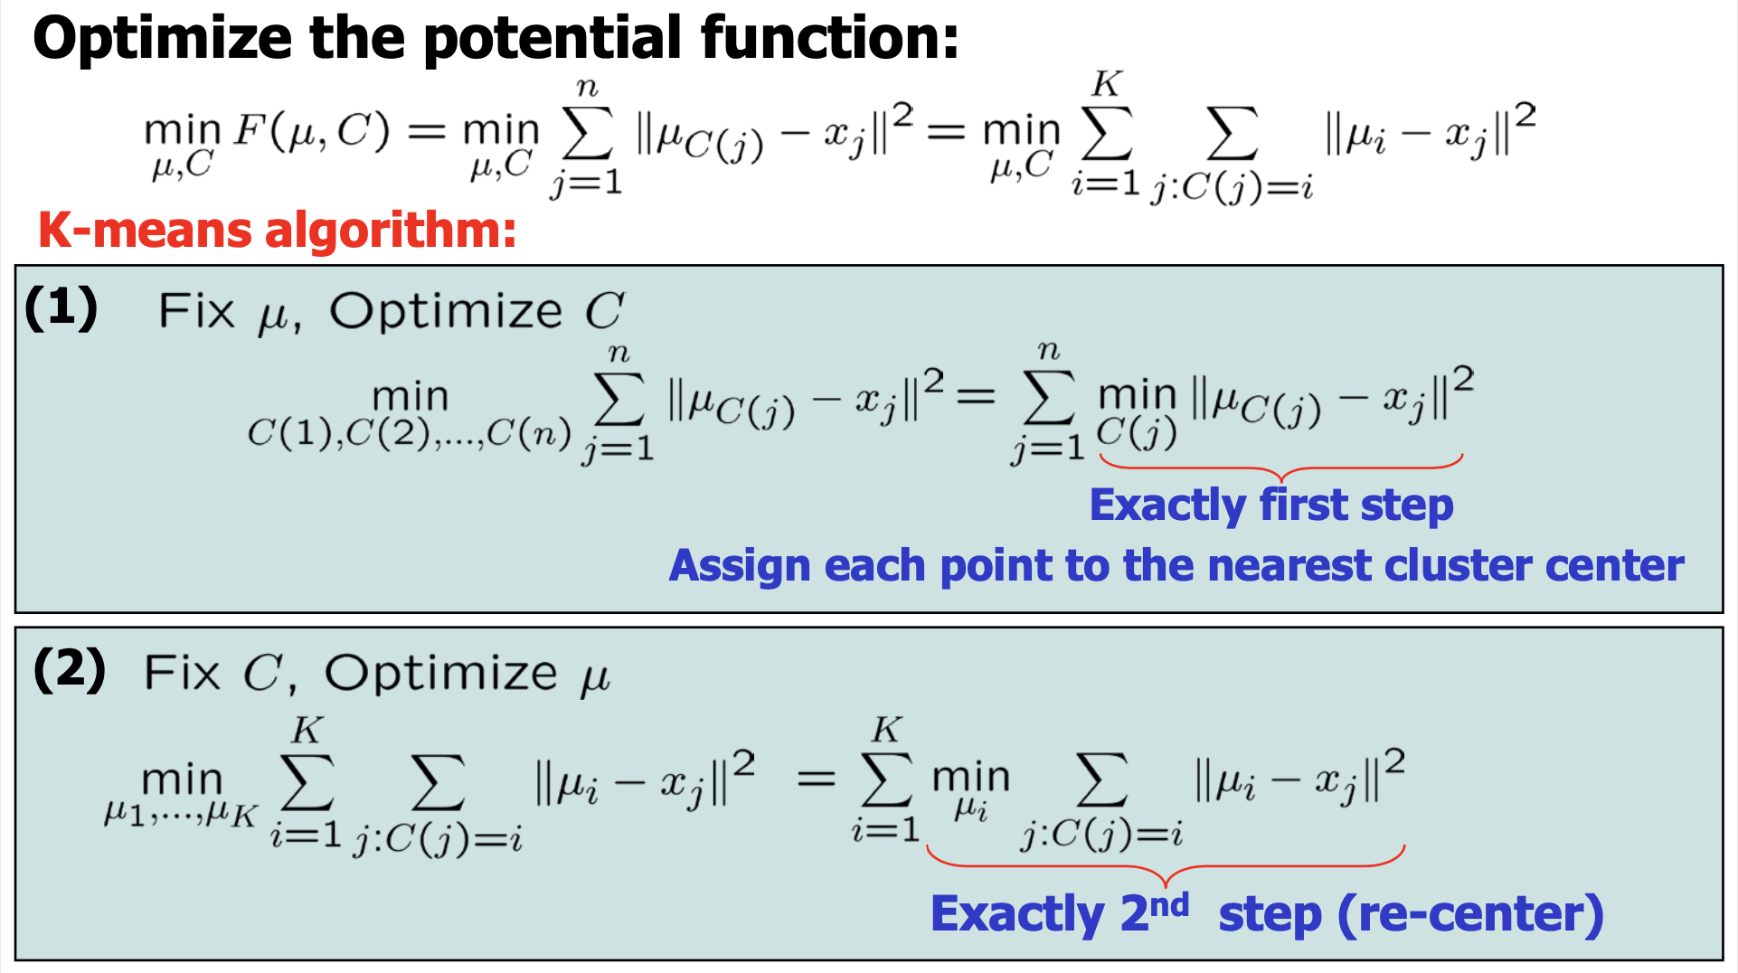
K-means Algorithm

Slide 24
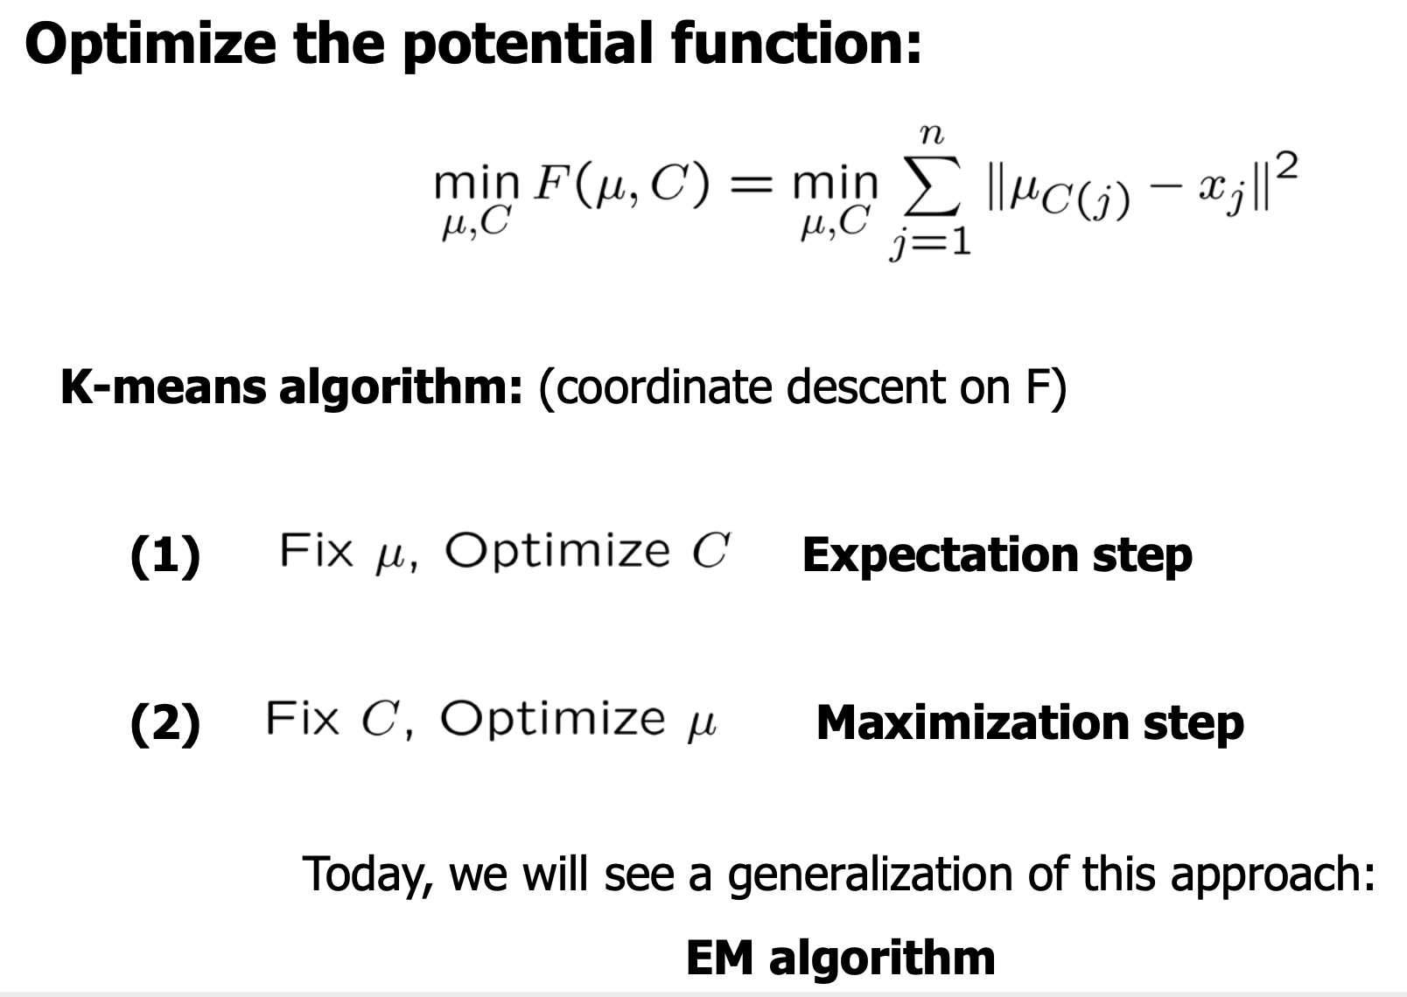
K-means Algorithm cont...

Slide 25
Gaussian Mixture Model

Slide 26
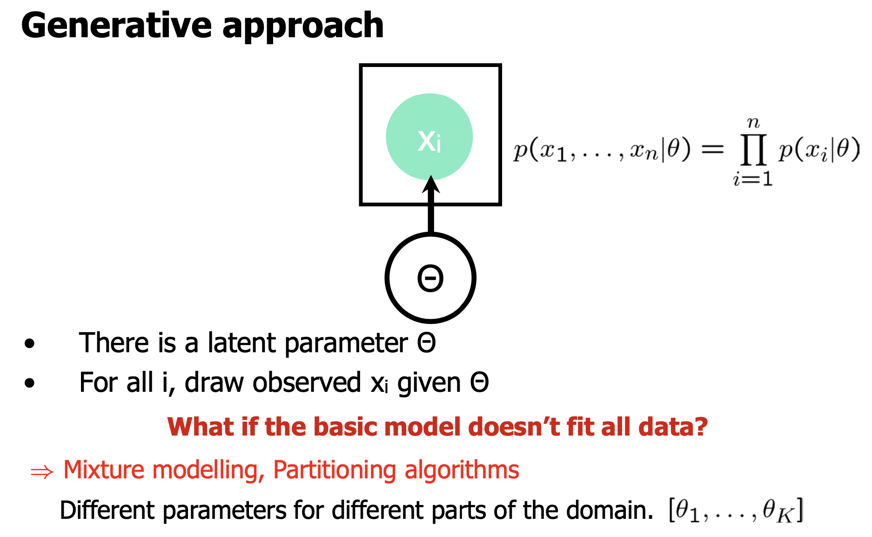
Density Estimation

Slide 27
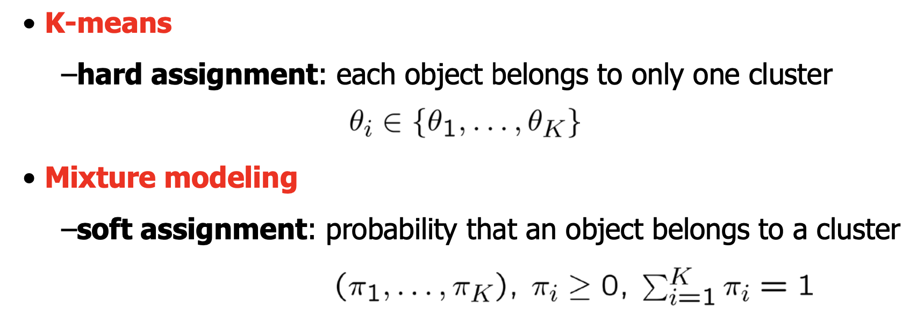
Partitioning Algorithms

Slide 28
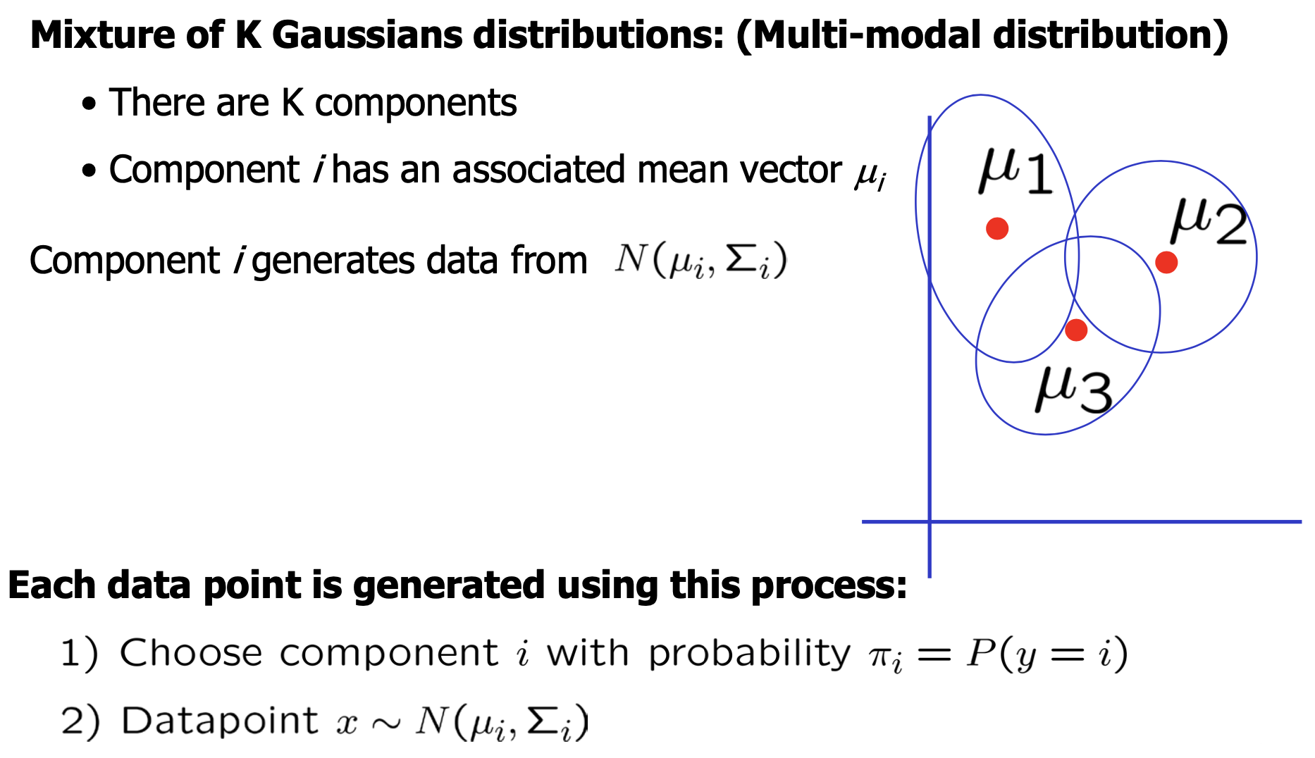
Gaussian Mixture Model

Slide 29
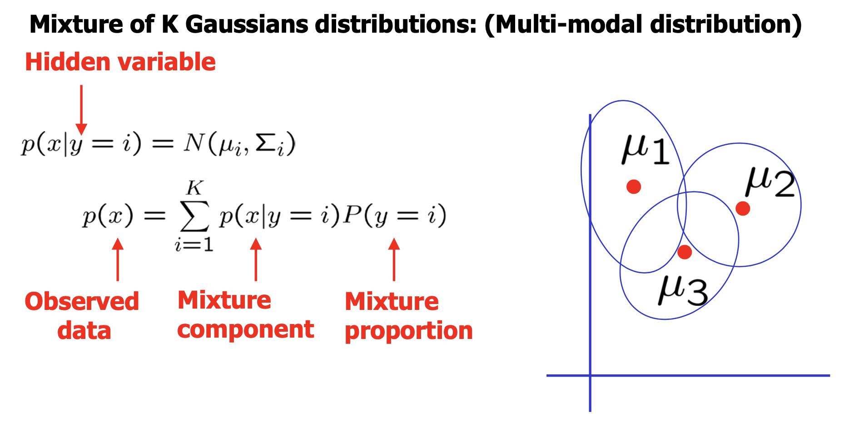
Gaussian Mixture Model cont...

Slide 30
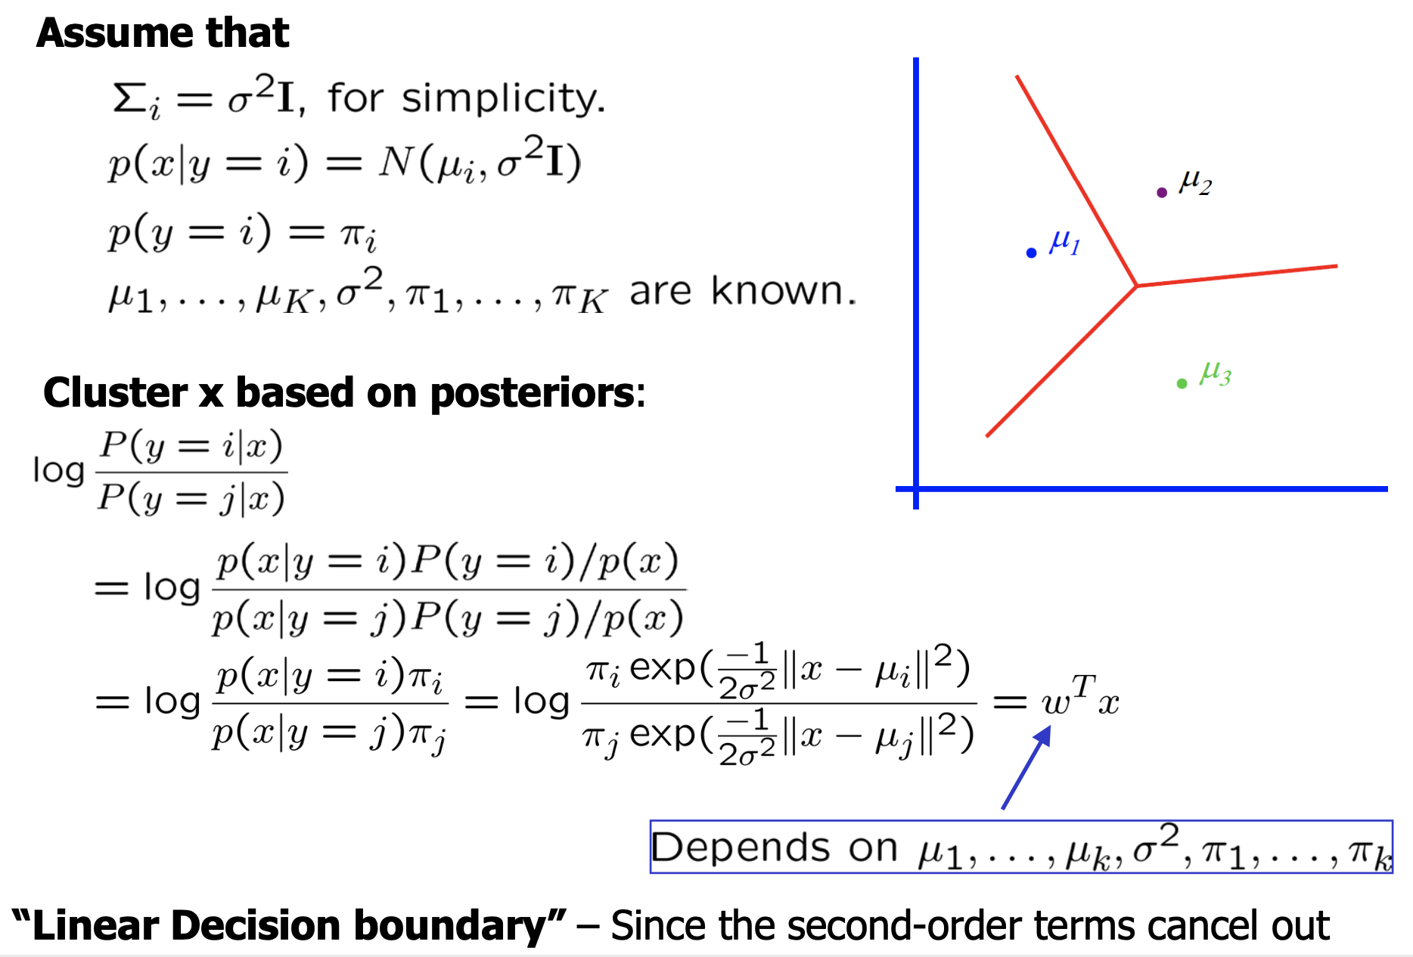
Mixture of Gaussians Clustering

Slide 31
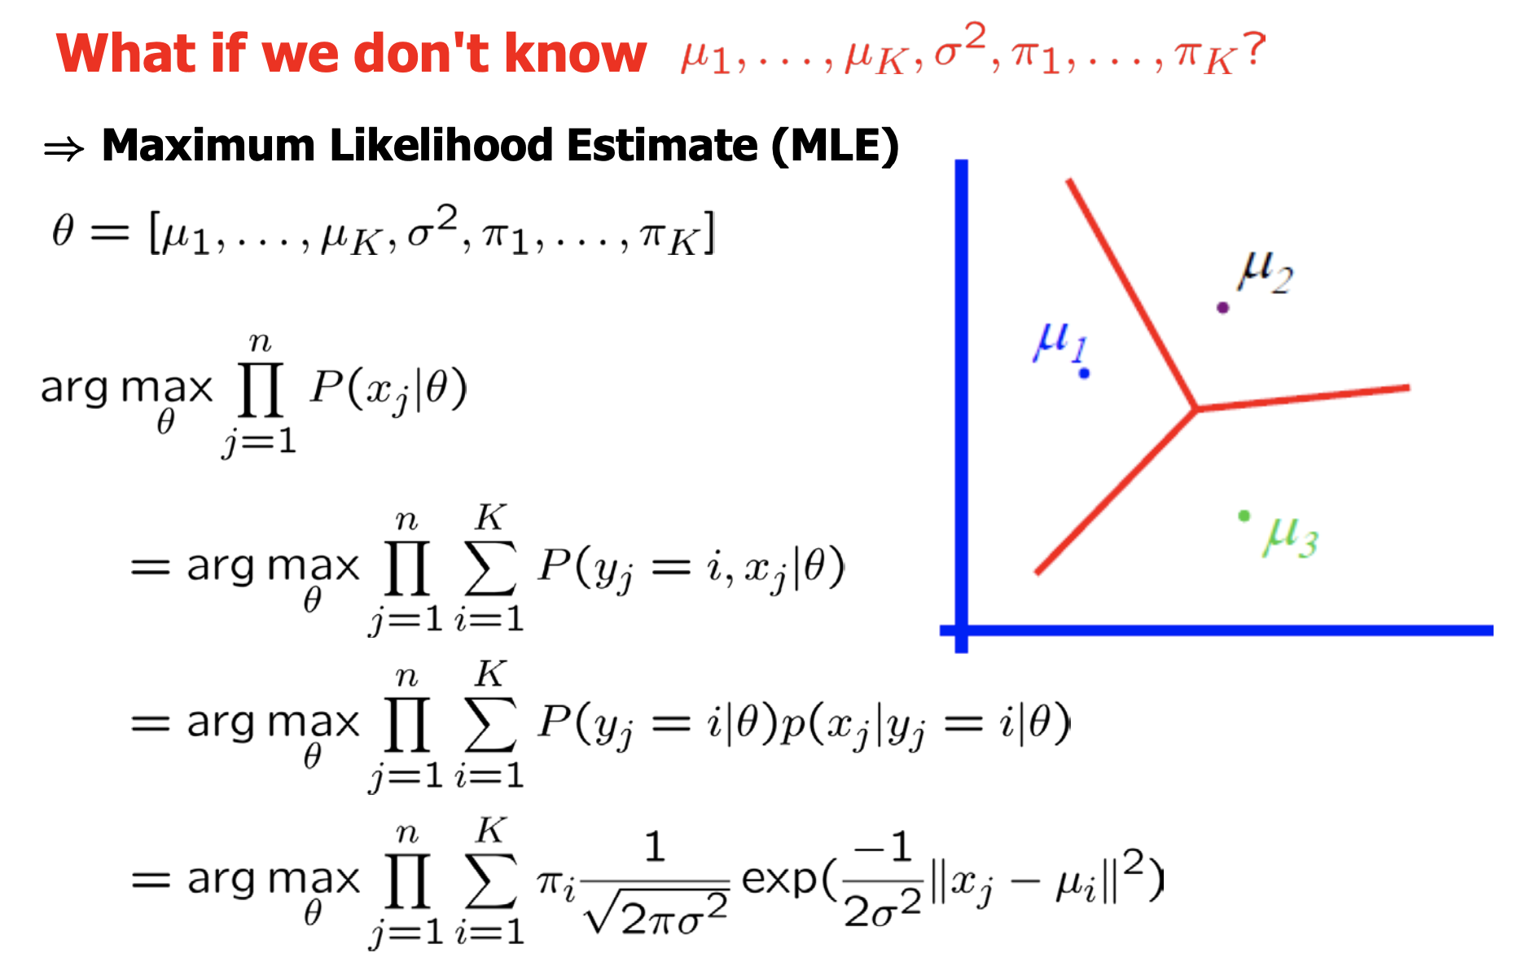
MLE for GMM

Slide 32
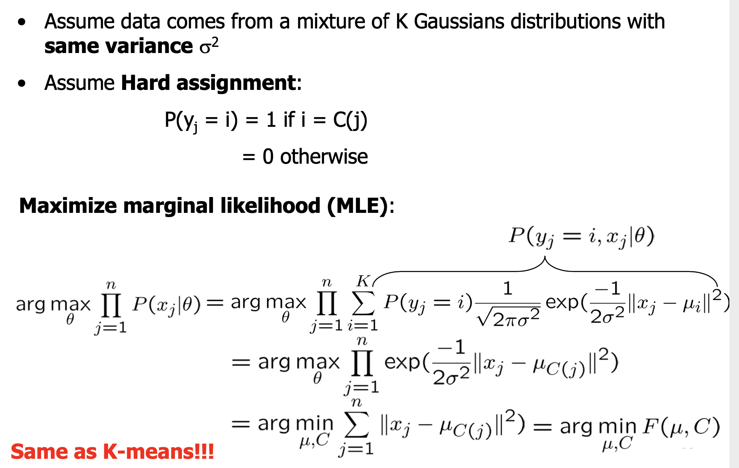
K-means and GMM

Slide 33
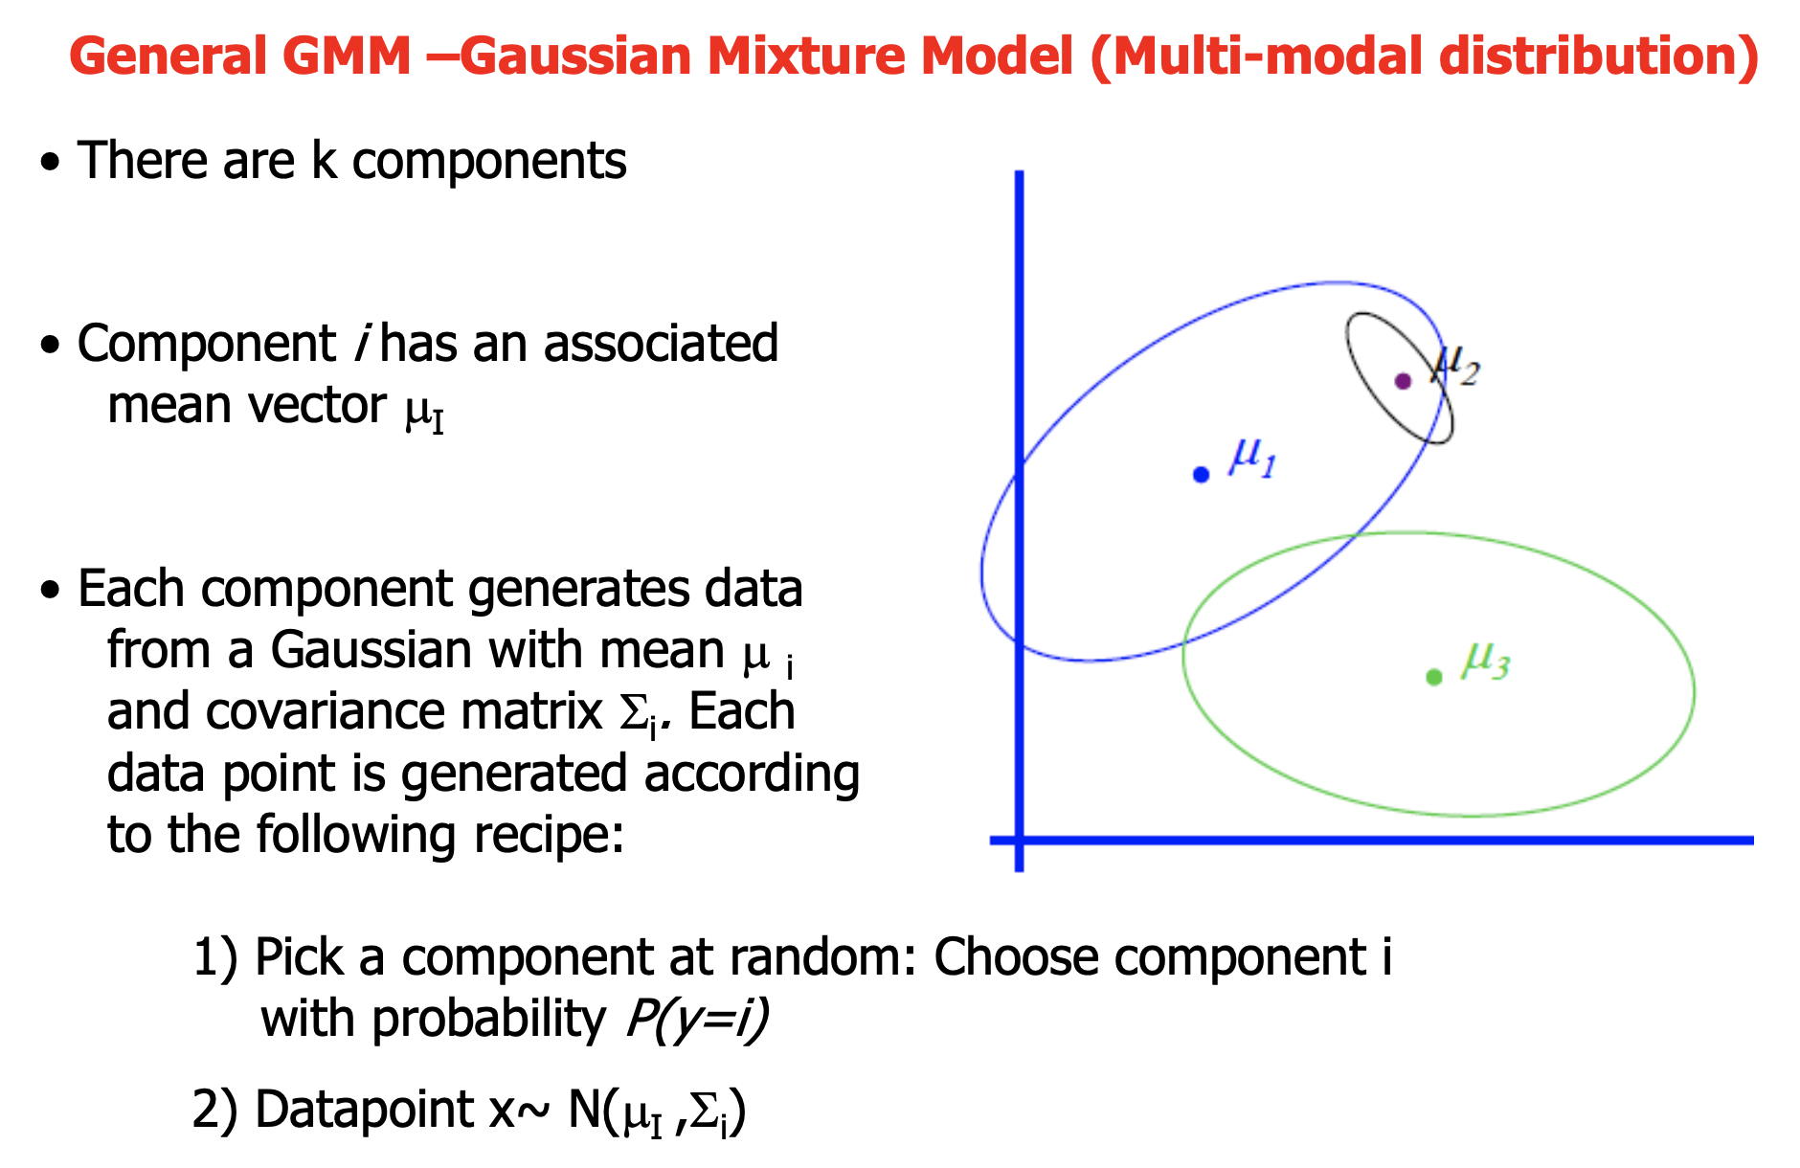
General GMM

Slide 34
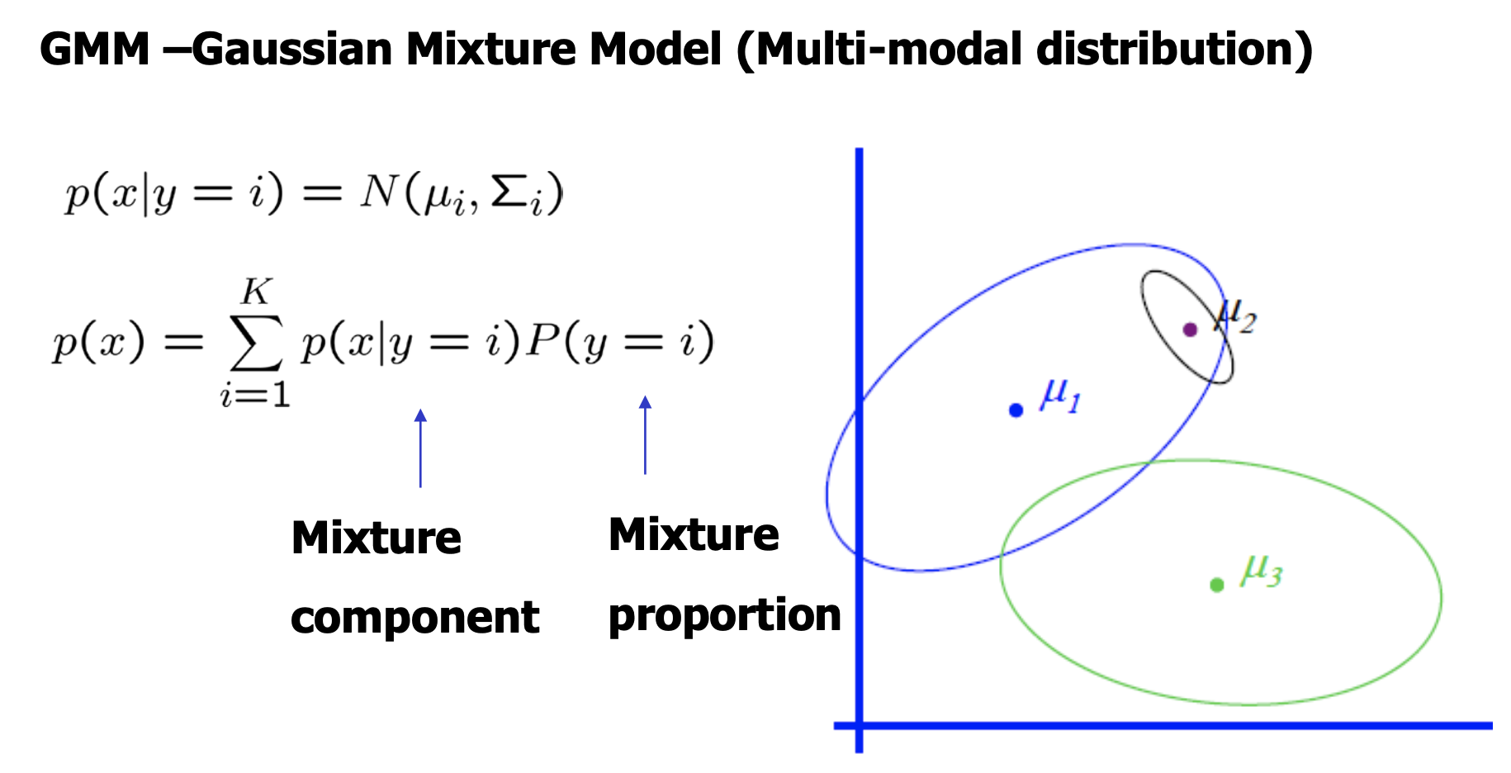
General GMM cont...

Slide 35
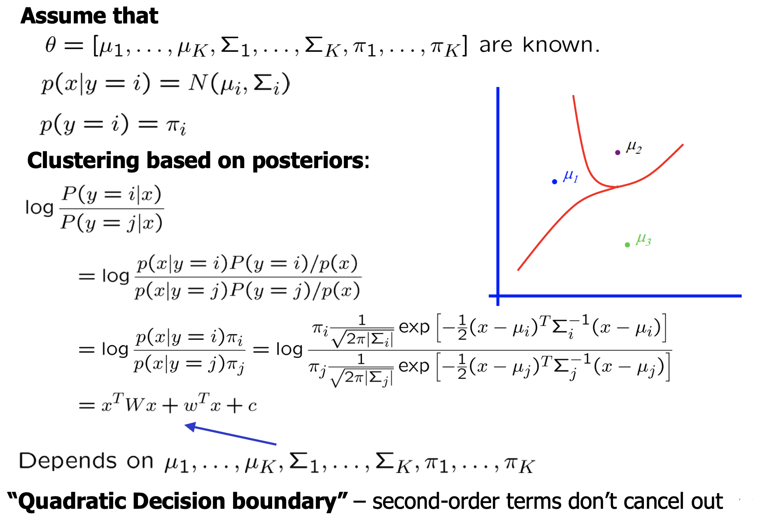
General GMM cont...

Slide 36
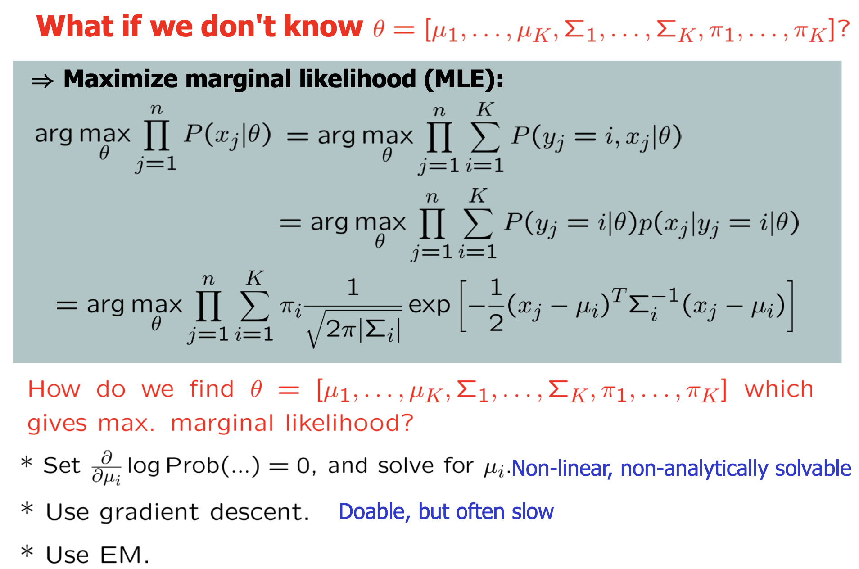
General GMM MLE Estimation

Slide 37
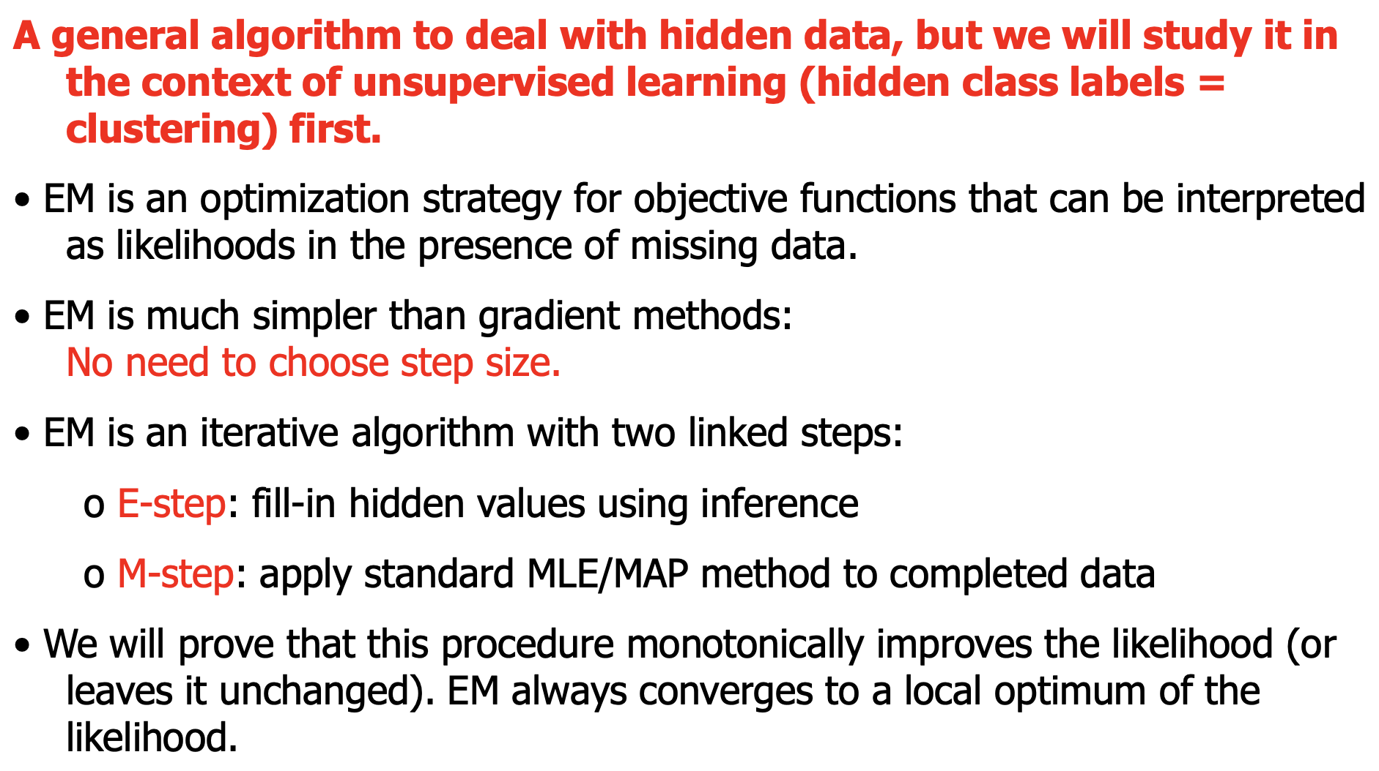
Expectation-Maximization (EM)

Slide 38
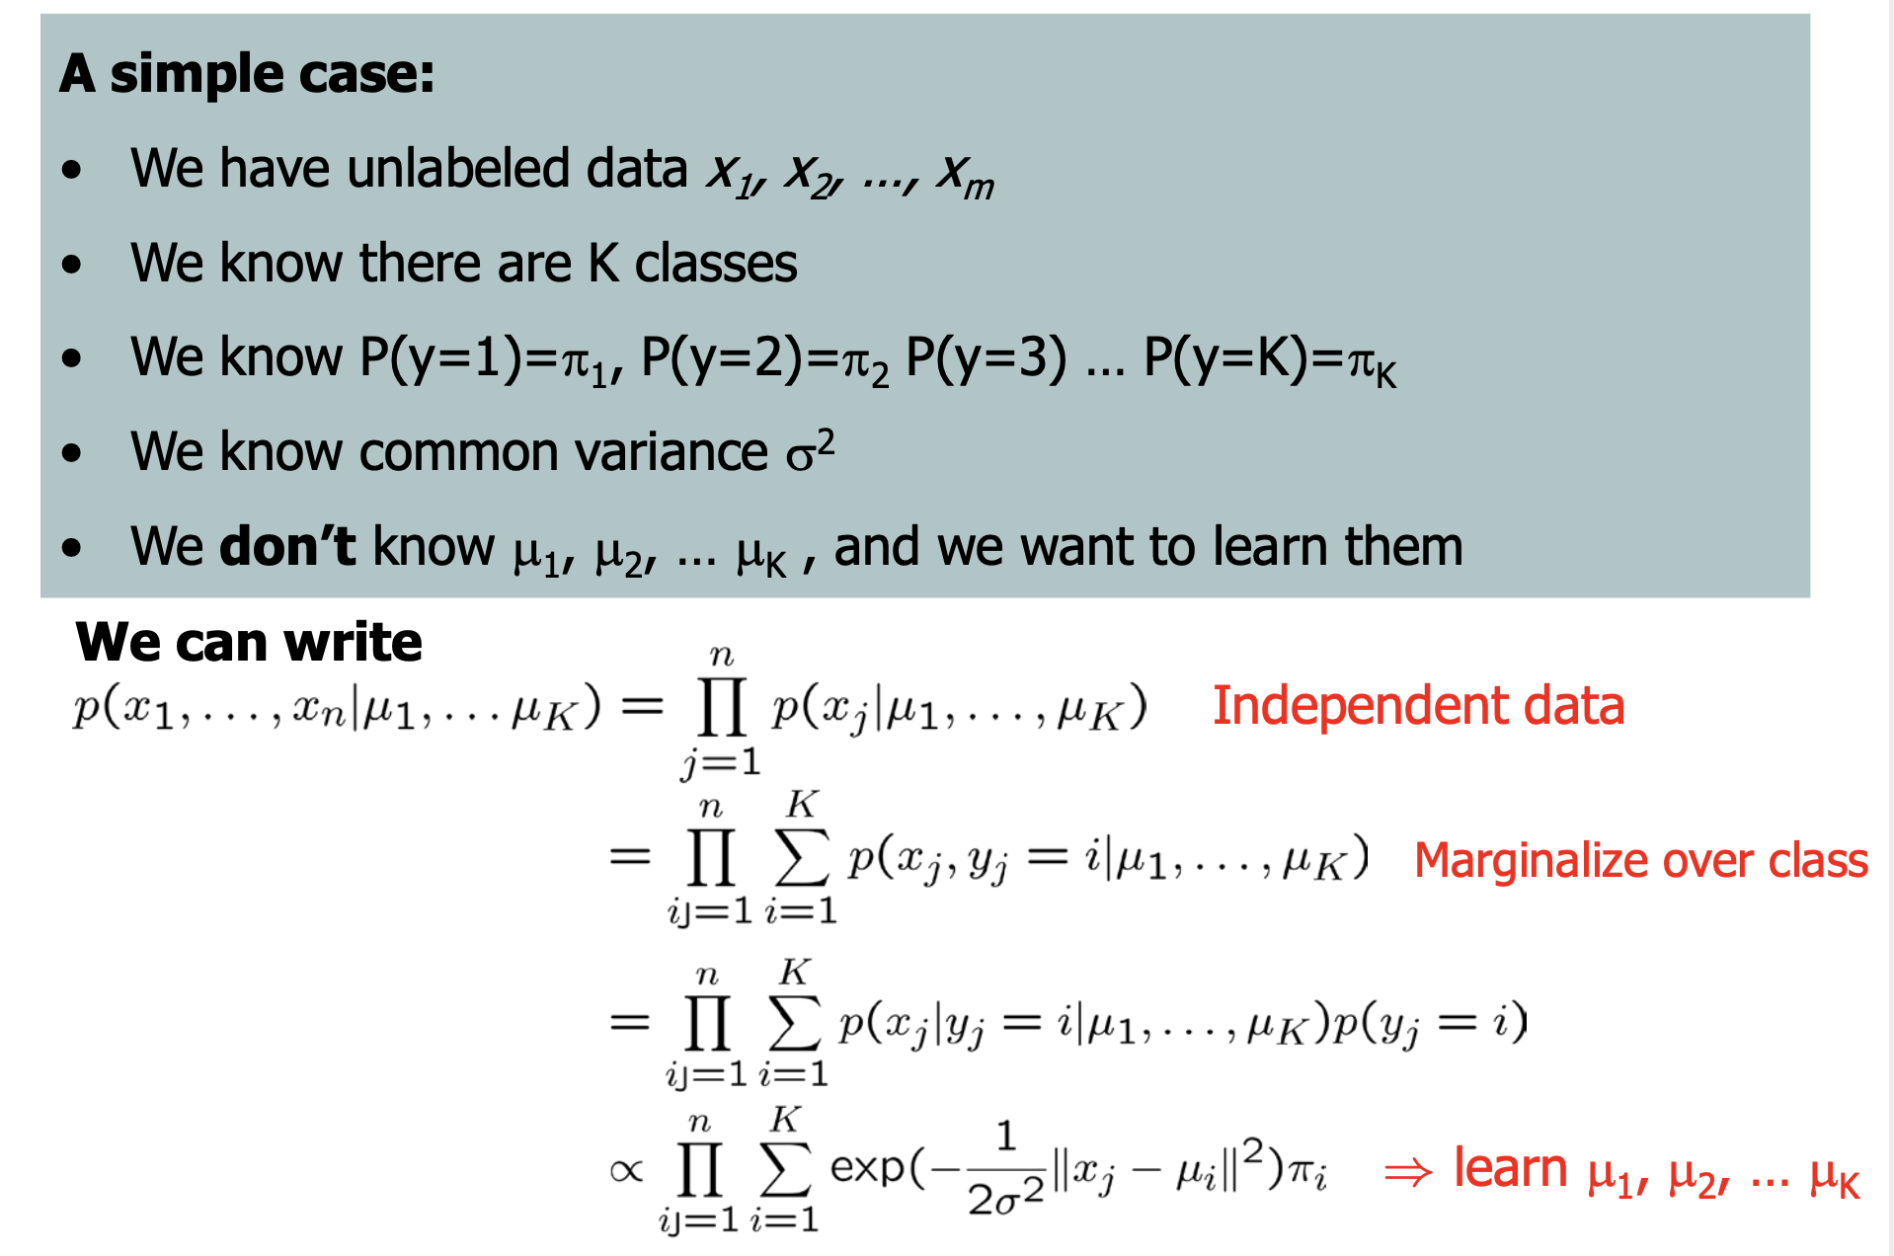
Expectation-Maximization (EM) cont...

Slide 39
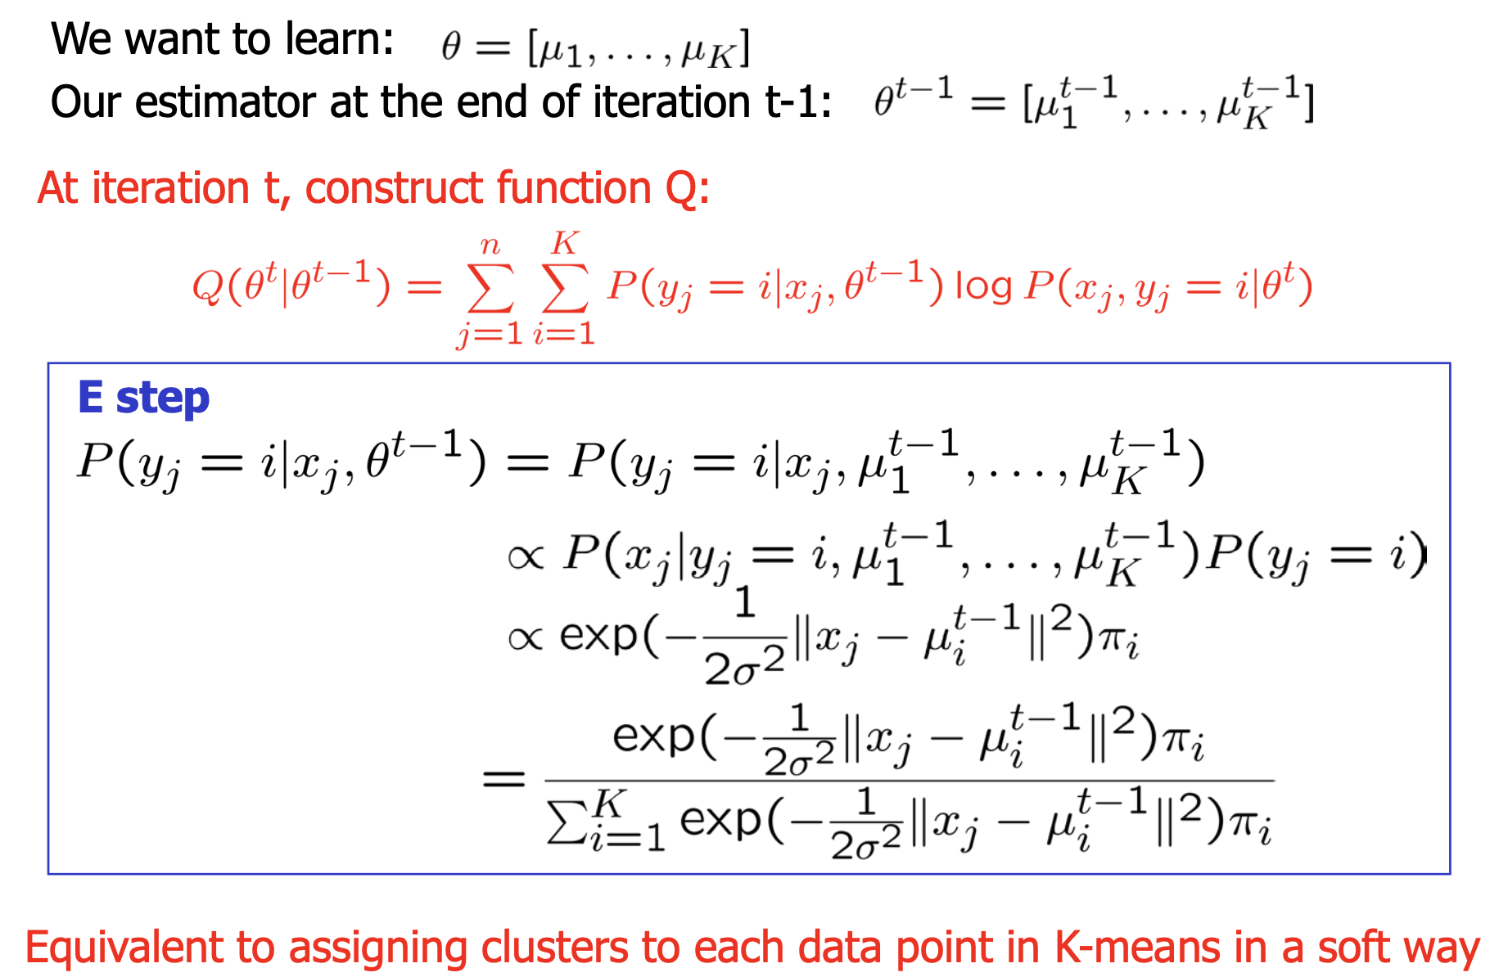
Expectation (E) step

Slide 40
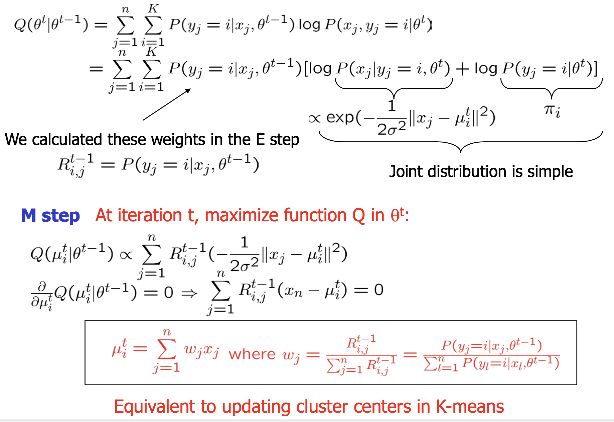
Maximization (M) step

Slide 41
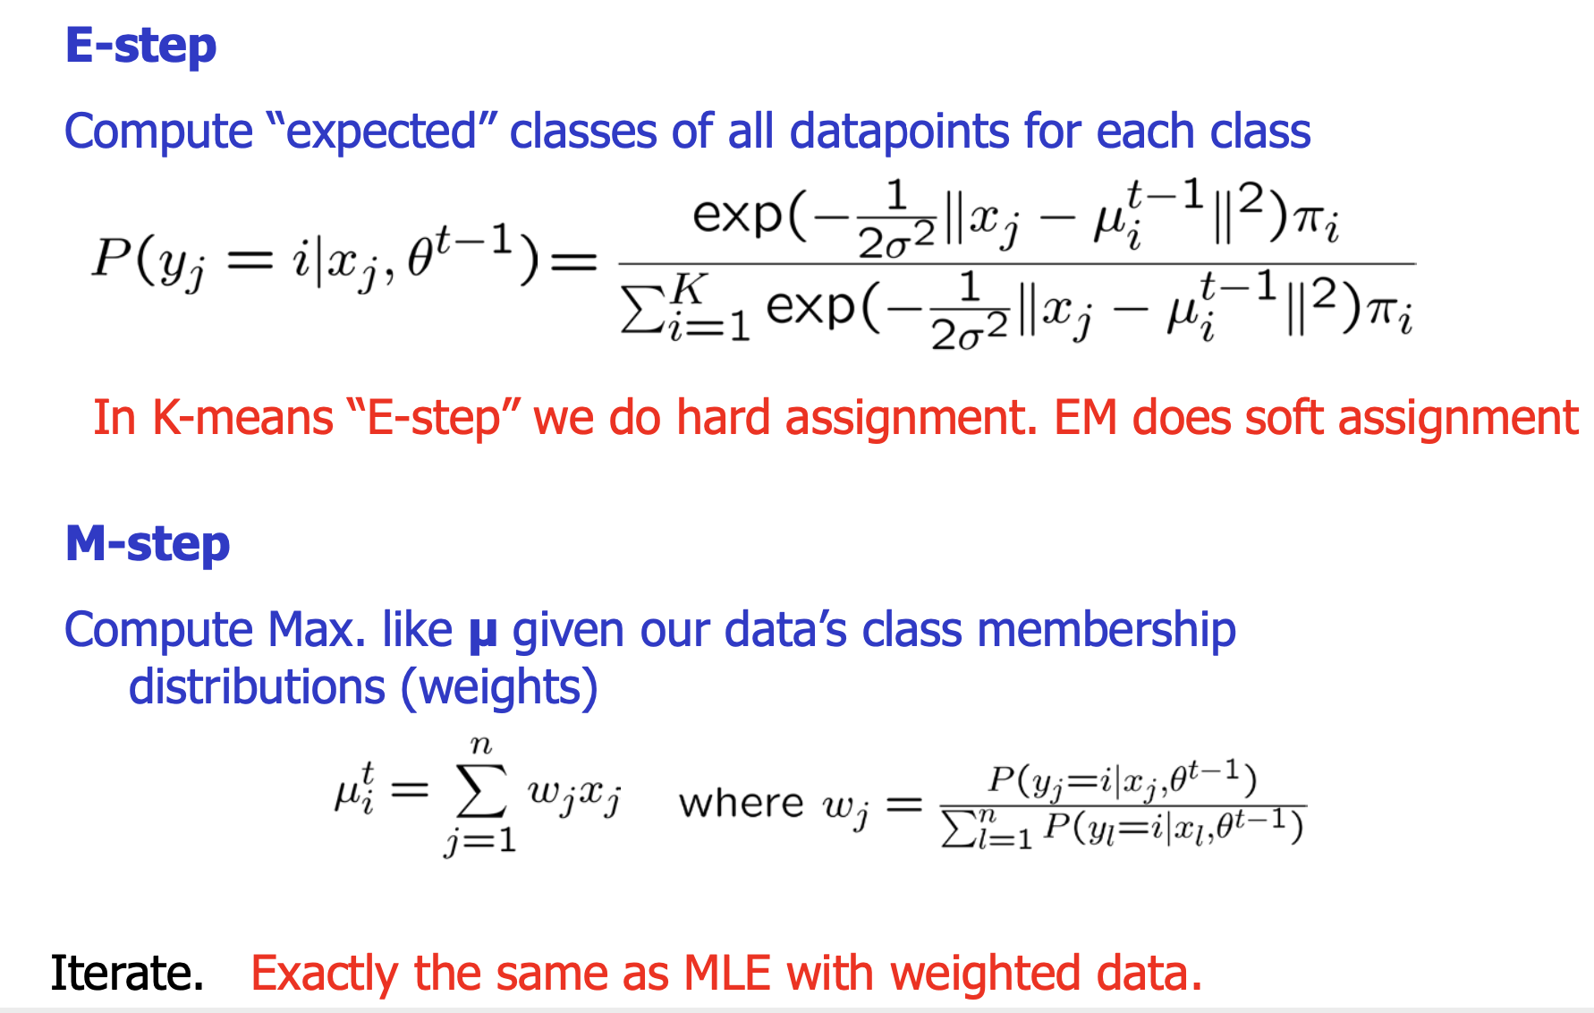
EM for spherical, same variance GMMs

Slide 42
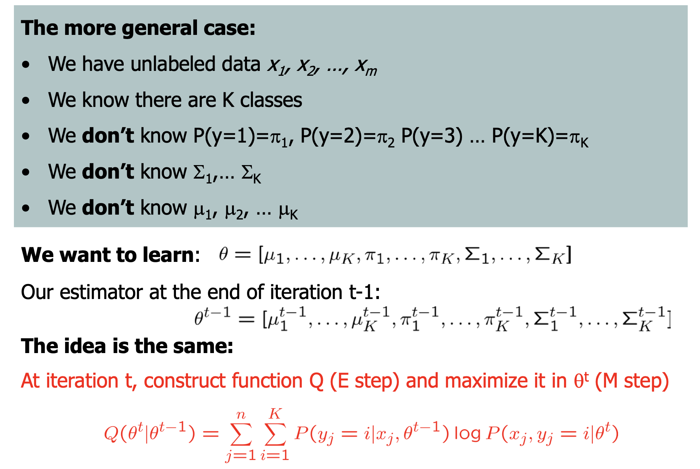
EM for general GMMs

Slide 43
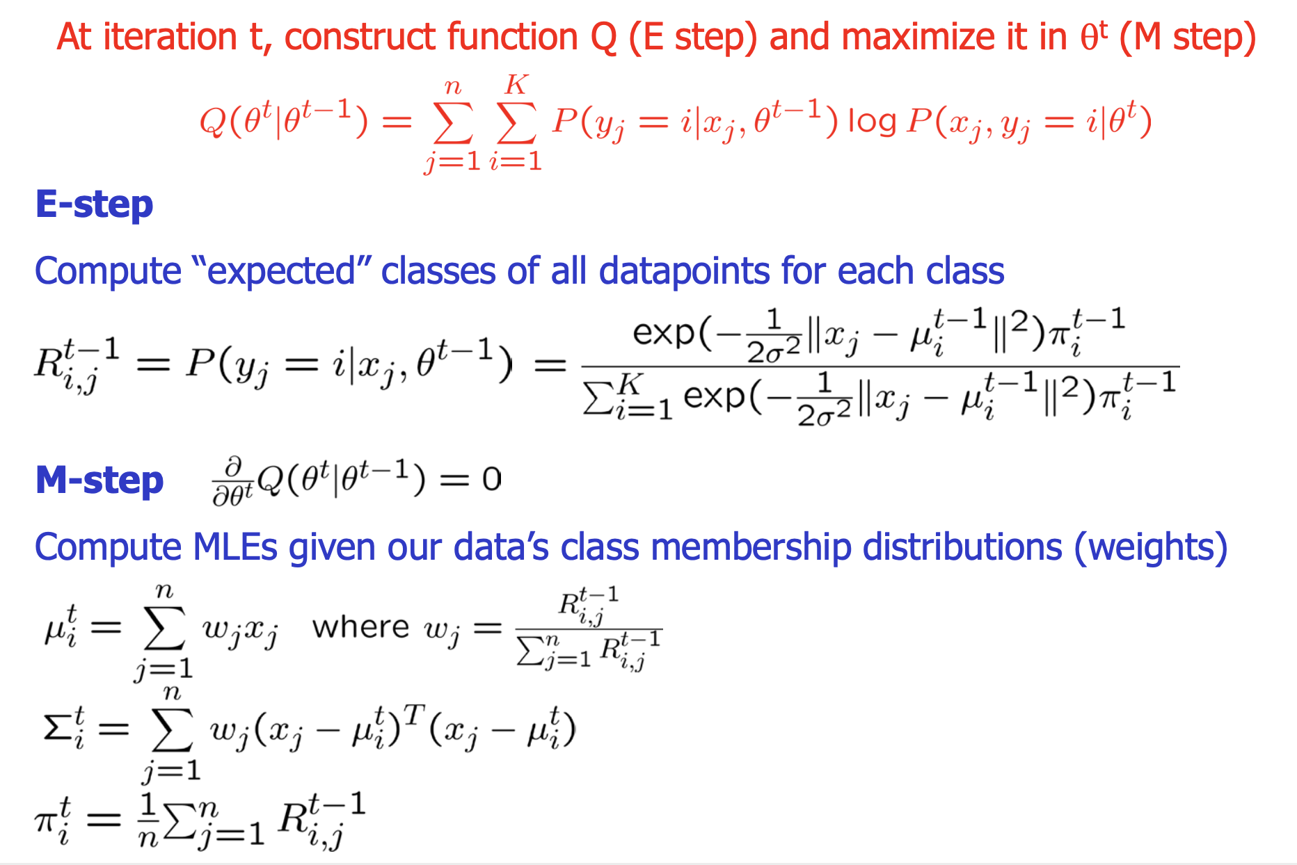
EM for general GMMs cont...

Slide 44
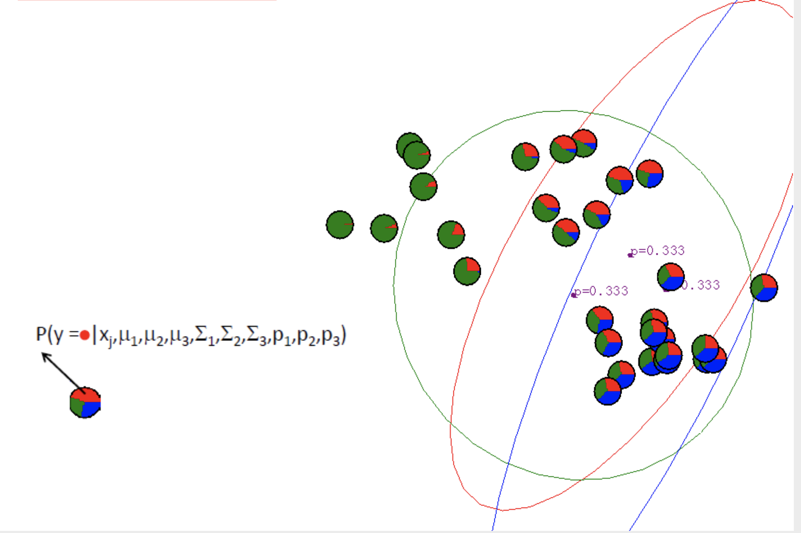
EM for general GMMs: Example

Slide 45
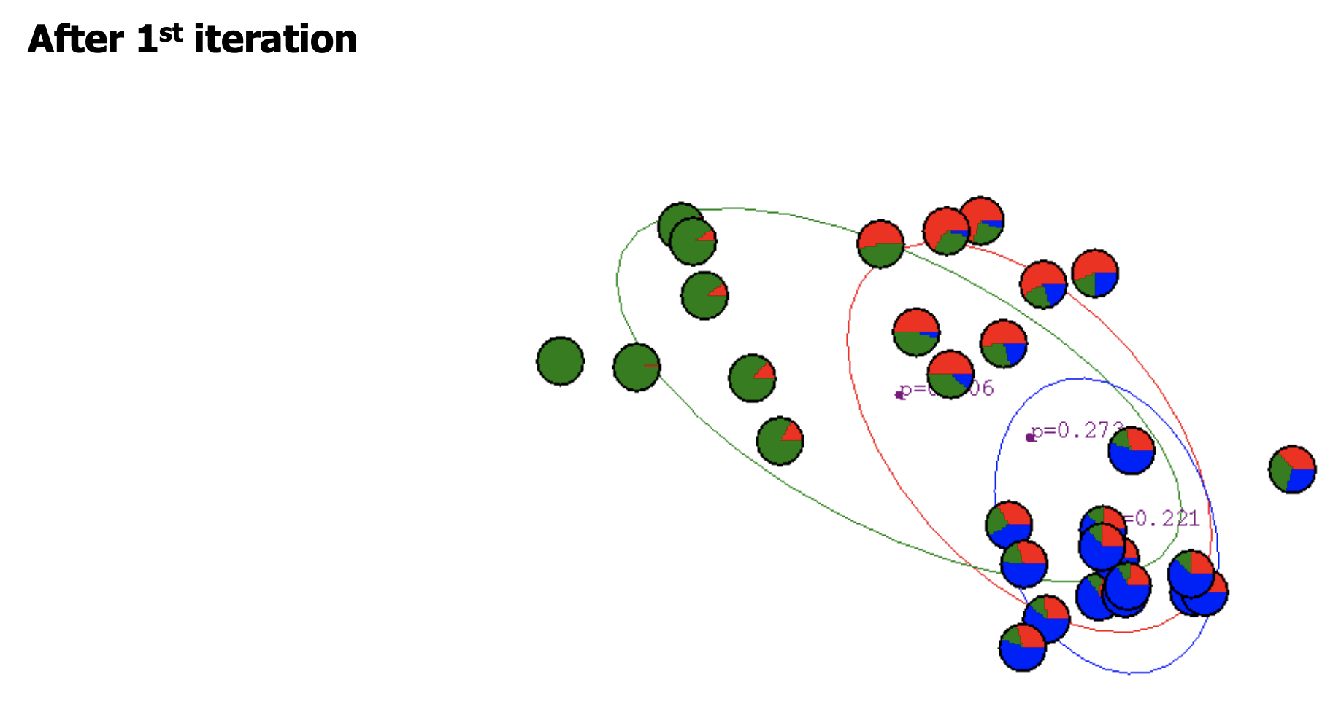
EM for general GMMs: Example cont...

Slide 46
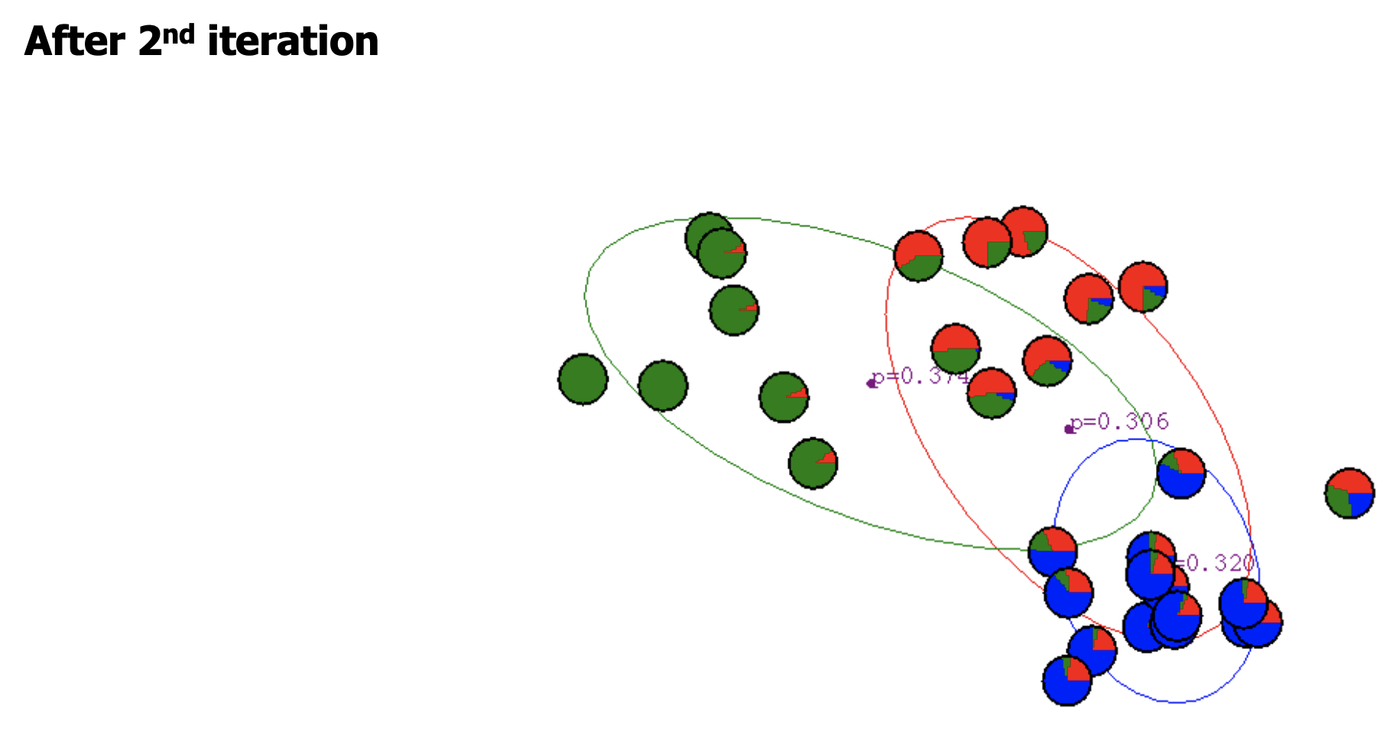
EM for general GMMs: Example cont...

Slide 47
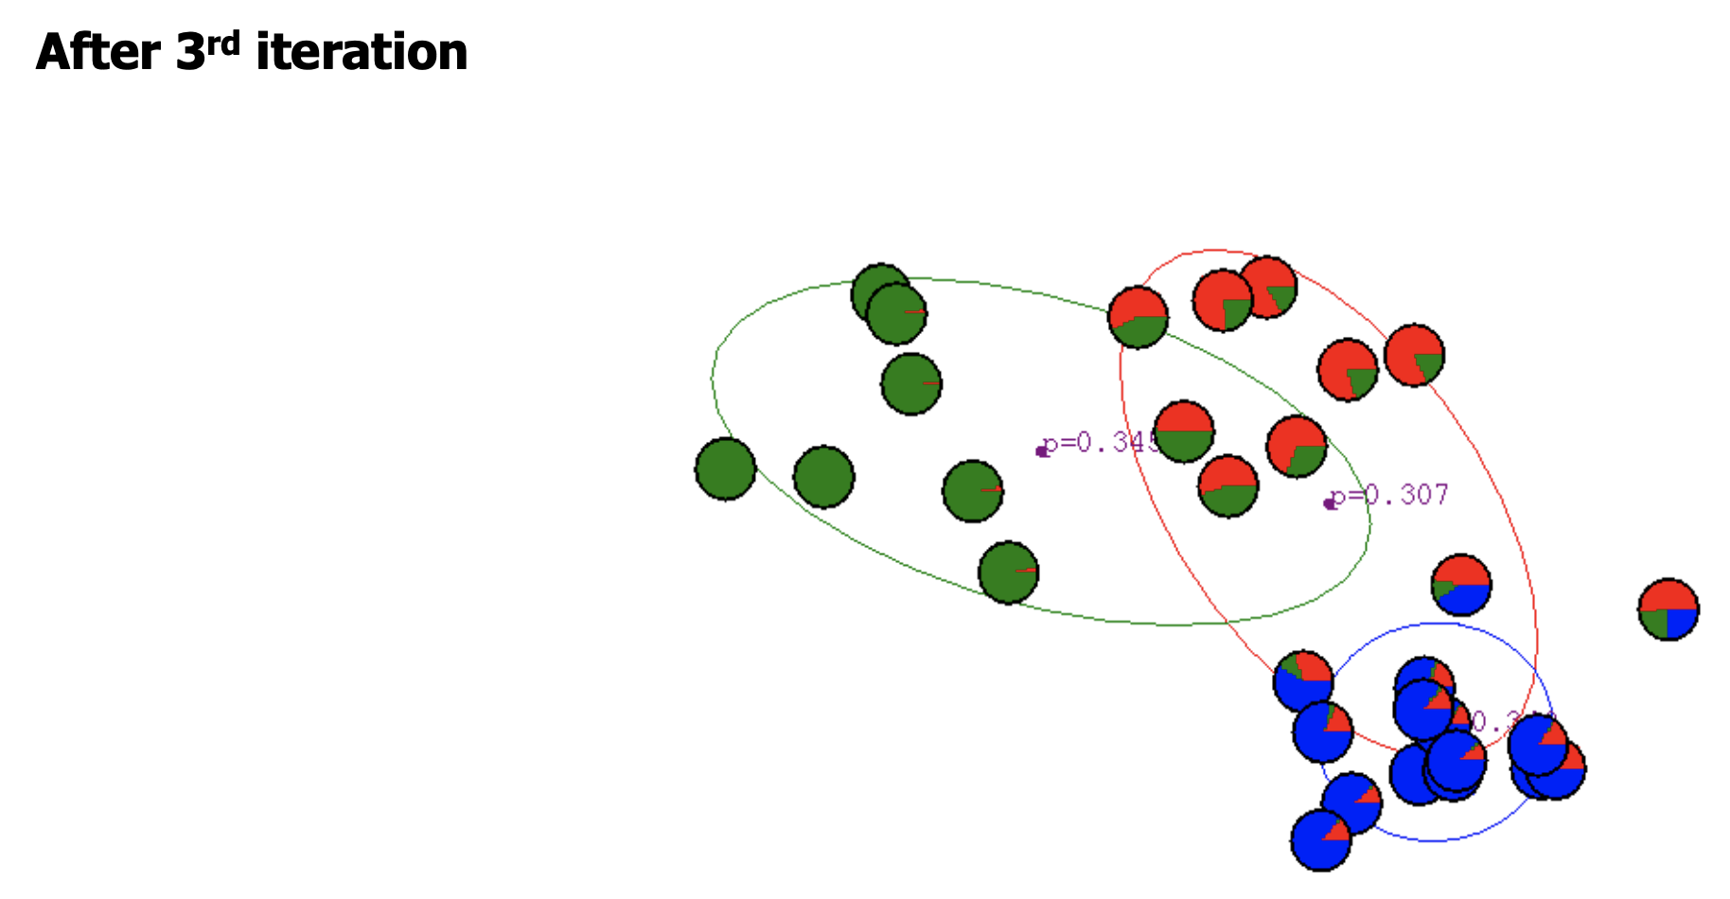
EM for general GMMs: Example cont...

Slide 48
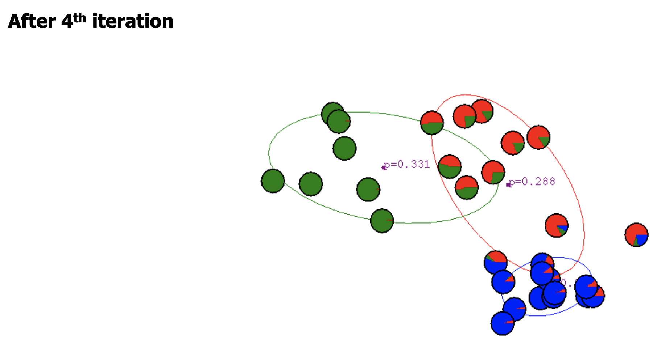
EM for general GMMs: Example cont...

Slide 49
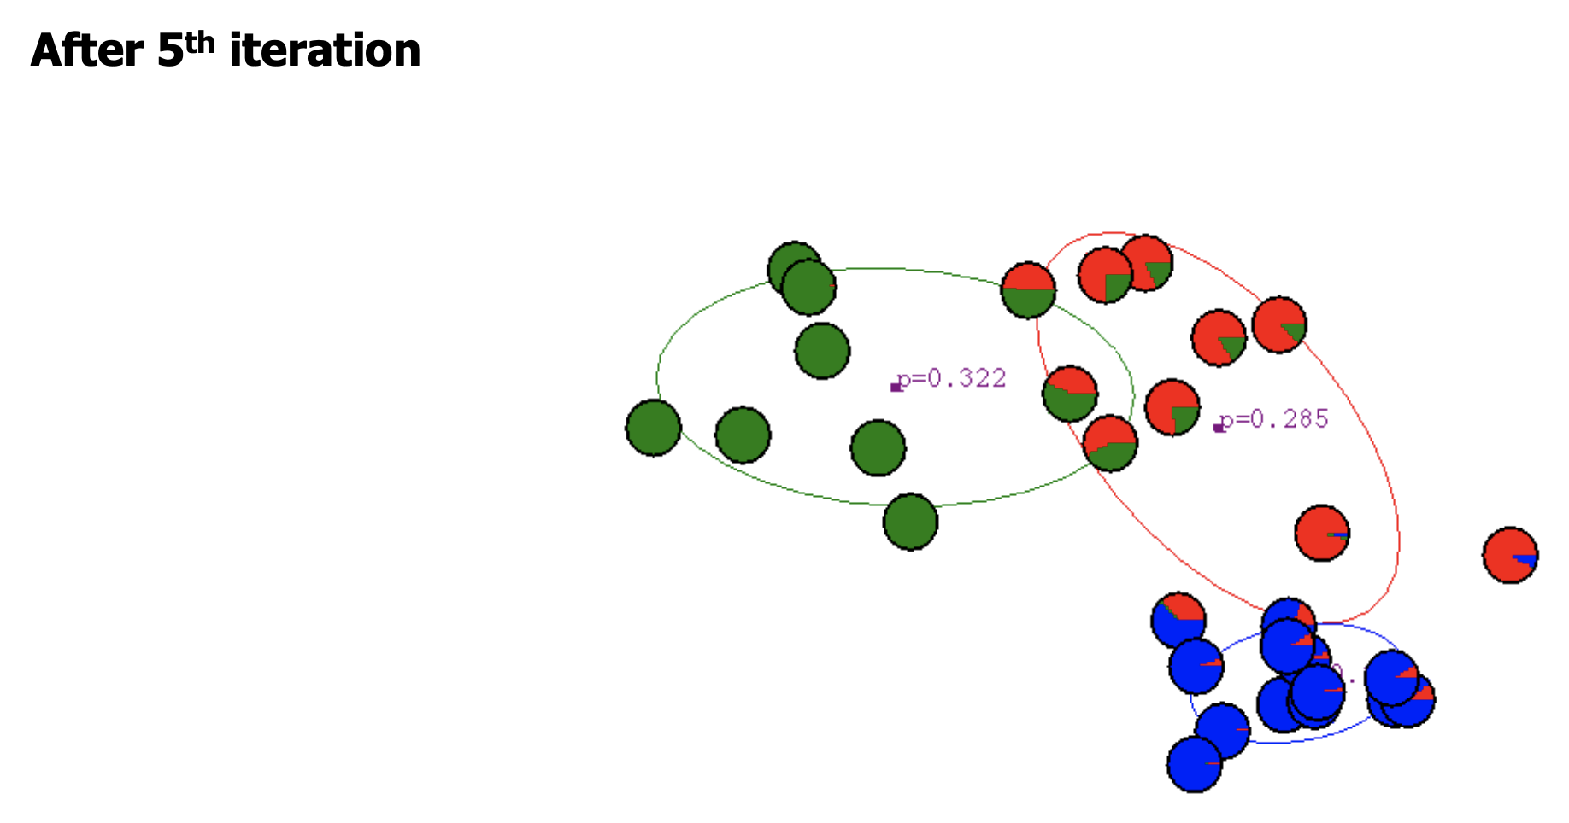
EM for general GMMs: Example cont...

Slide 50
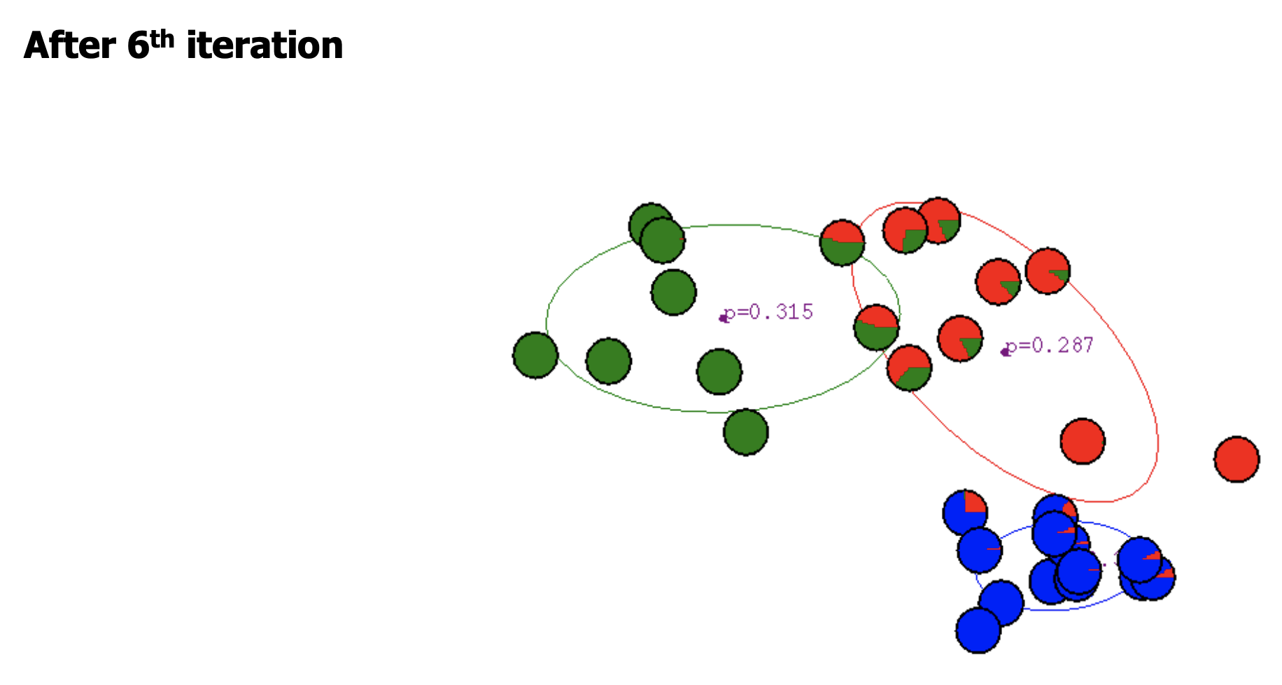
EM for general GMMs: Example cont...

Slide 51
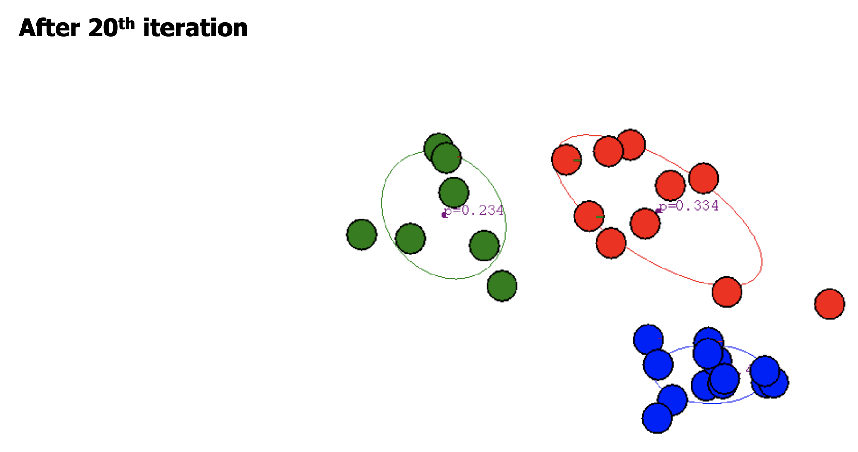
EM for general GMMs: Example cont...

Slide 52
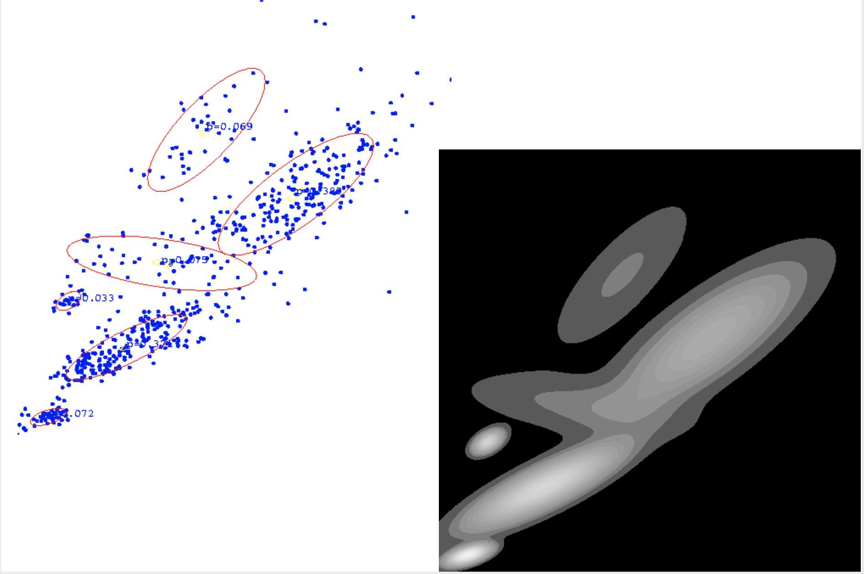
GMM for Density Estimation

Slide 53
General EM algorithm
What is EM in the general case, and why does it work?

Slide 54
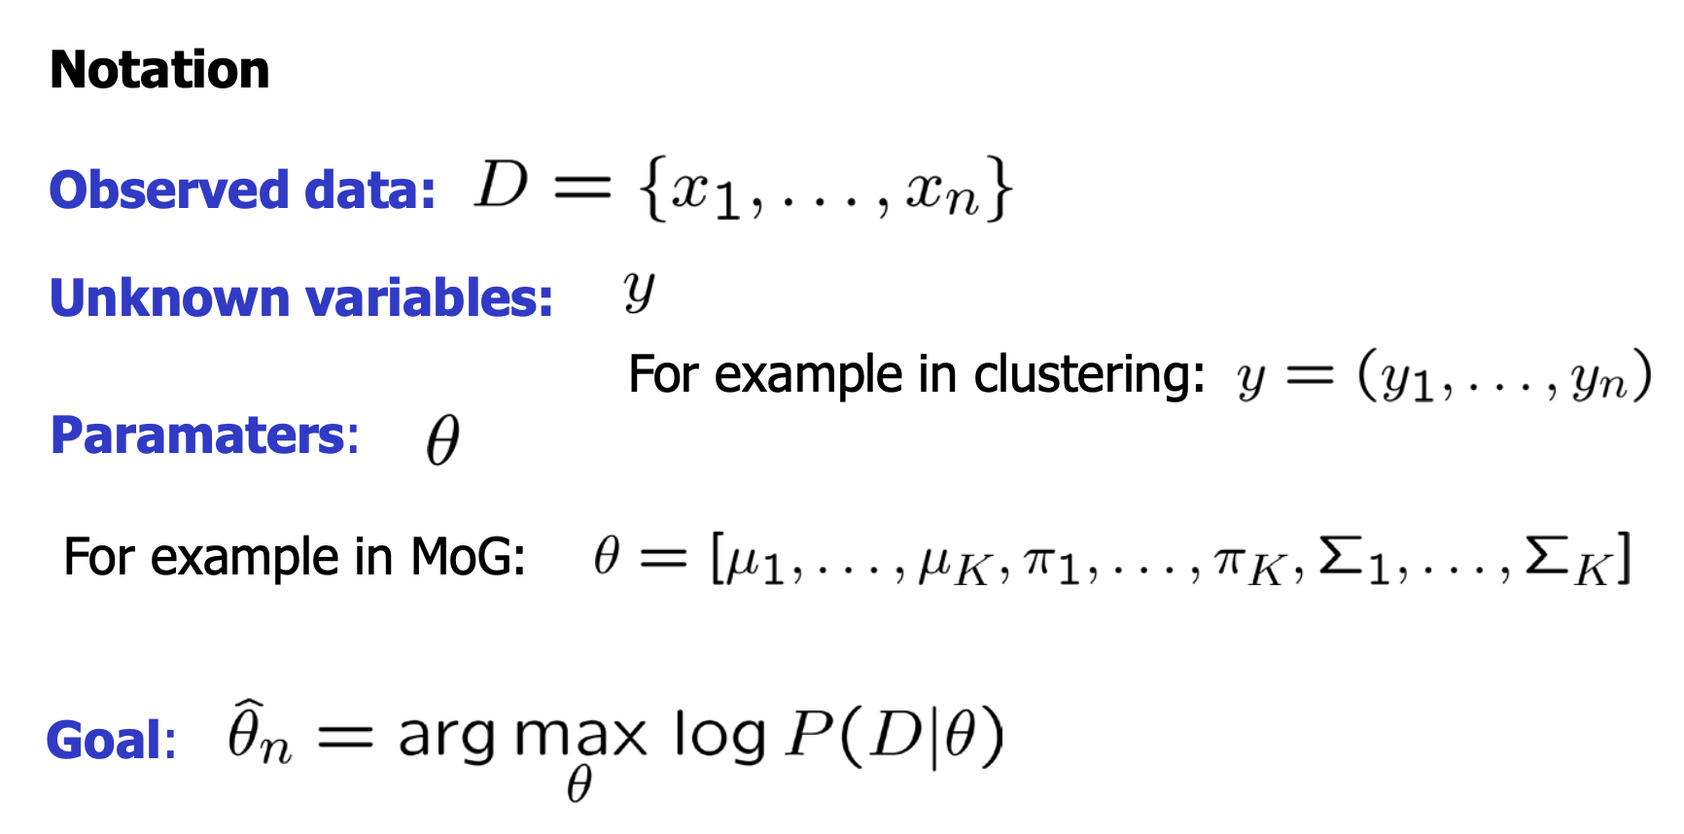
General EM algorithm

Slide 55
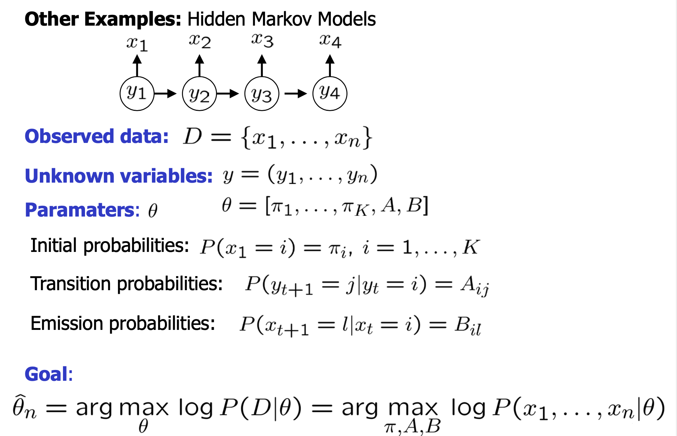
General EM algorithm cont...

Slide 56
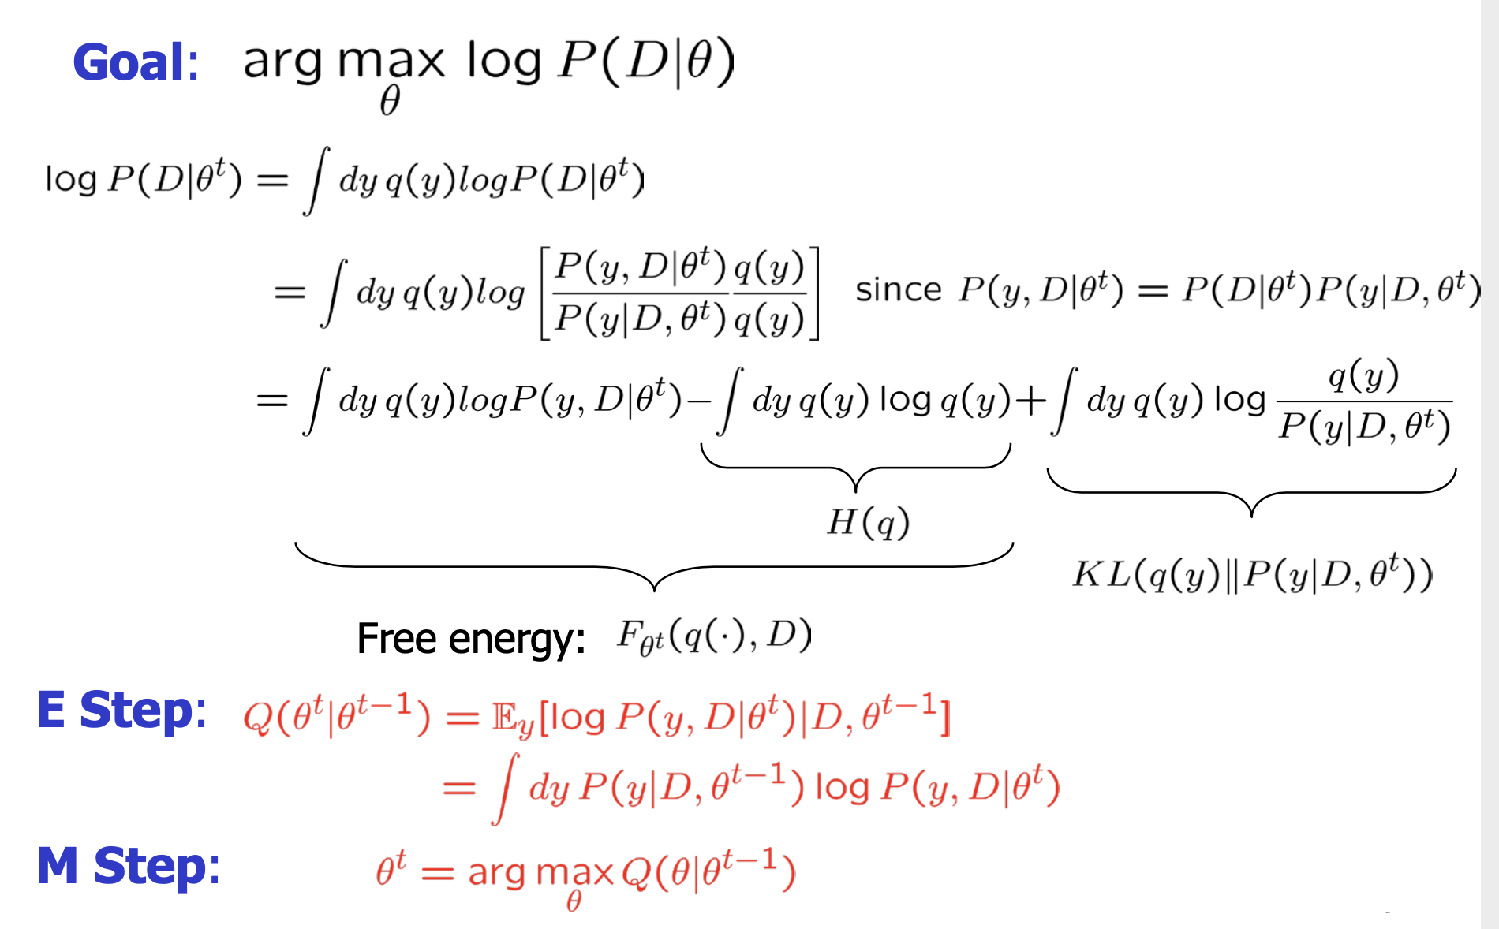
General EM algorithm cont...

Slide 57
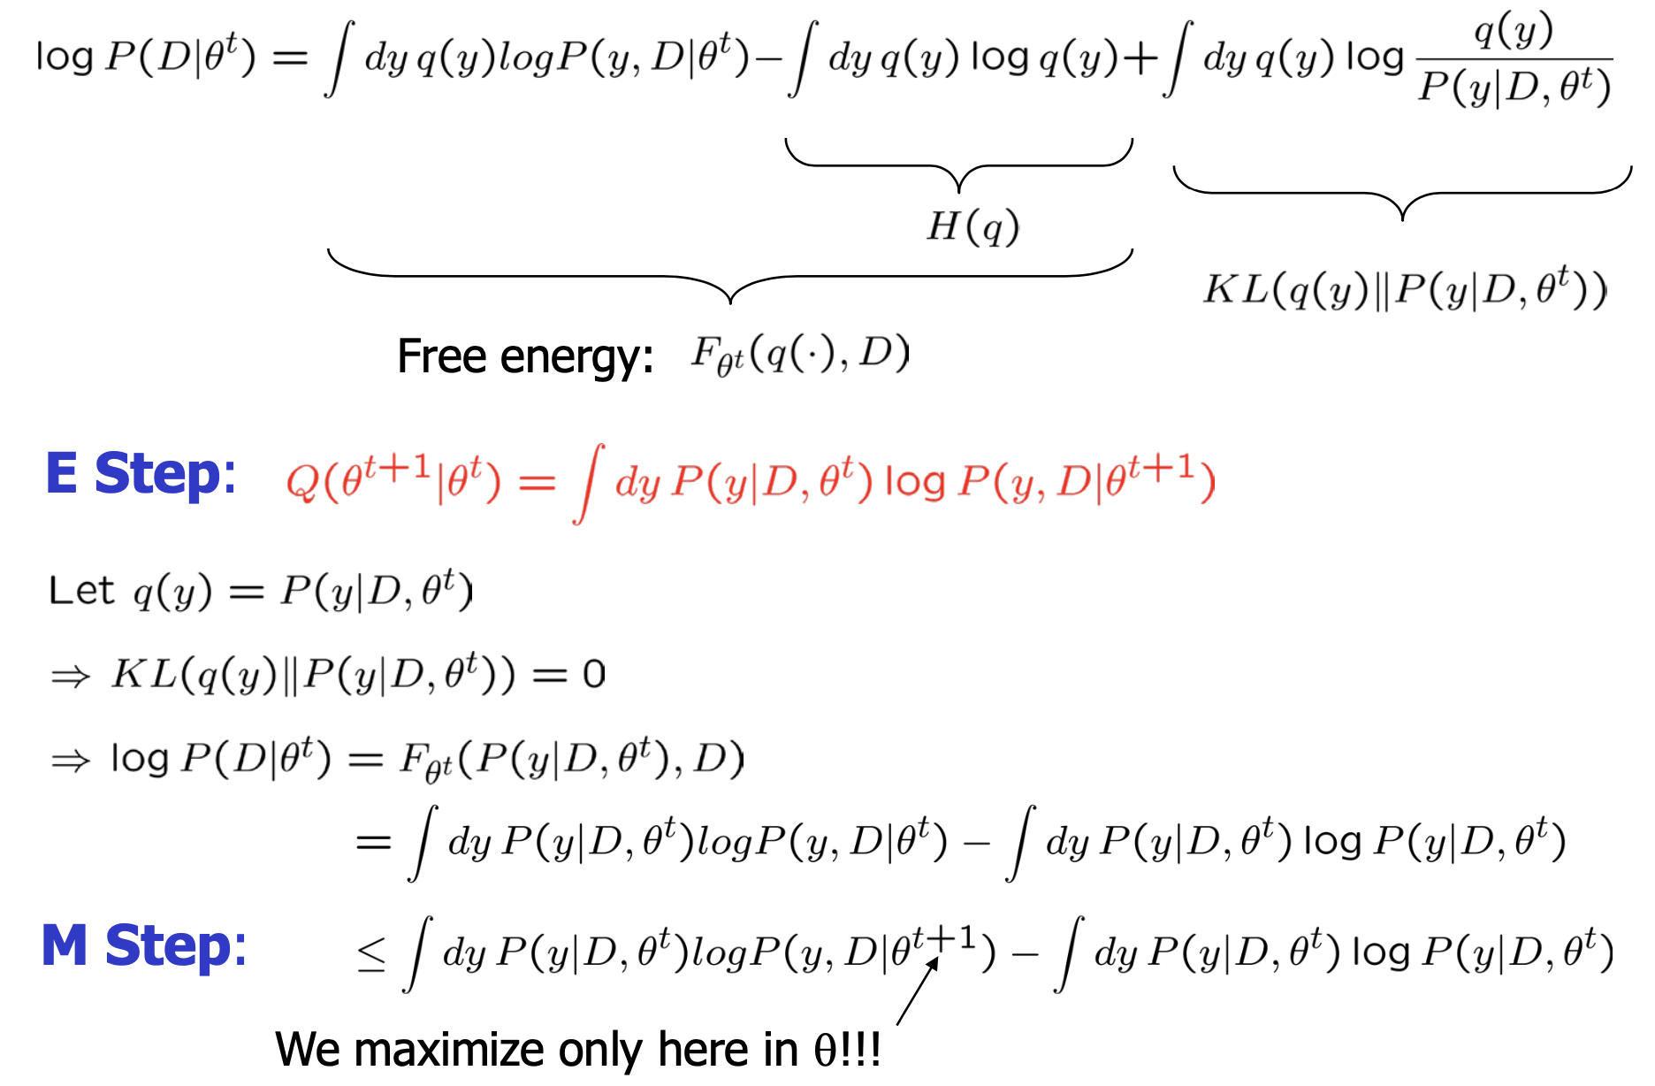
General EM algorithm cont...

Slide 58

General EM algorithm cont...

Slide 59

General EM algorithm cont...

Slide 60

Convergence of EM

Slide 61

Convergence of EM cont...

Slide 62
Variational Methods

Slide 63

Variational methods

Slide 64

Variational methods cont...

Slide 65

Summary: EM Algorithm

Slide 66
Spectral Clustering

Slide 67

Spectral clustering

Slide 68

Spectral clustering cont...

Slide 69

Data Clustering

Slide 70

Graph Clustering

Slide 71

Similarity graph construction

Slide 72

Partitioning a graph into two clusters

Slide 73

Partitioning a graph into two clusters cont...

Slide 74

Normalized Cut and Graph Laplacian

Slide 75

Normalized Cut and Graph Laplacian cont...

Slide 76

Approximation of Normalized cut

Slide 77


Slide 78
How to partition a graph into k clusters?

Slide 79

Spectral Clustering Algorithm

Slide 80

Eigenvectors of Graph Laplacian

Slide 81

Why does it work?

Slide 82

Understanding Spectral Clustering

Slide 83

Understanding Spectral Clustering cont...

Slide 84

Why does it work?

Slide 85

Why does it work? Cont...

Slide 86

Understanding Spectral Clustering

Slide 87

k-means vs Spectral clustering

Slide 88

k-means vs Spectral clustering cont...

Slide 89

k-means vs Spectral clustering cont...

Slide 90


Slide 91


Slide 92

Some Issues

Slide 93

Some Issues cont...

Slide 94

Some Issues cont...

Slide 95

Spectral clustering summary

